Slide 1



SELLINGER APPLIED PORTFOLIO
Portfolio Review | Summer 2017

Slide 2
Table of Contents
Overview
Economic Conditions
Sector Review
Portfolio Strategy & Composition
Professor & Student Biographies
Risk Analysis
Performance Review

Slide 3
OVERVIEW

Slide 4

Overview
The Sellinger Applied Portfolio (SAP) Class is designed to allow Loyola’s finance students to gain practical experience in portfolio management, including asset valuation, constraint setting, asset allocation, asset selection, risk management, and performance evaluation. The class is allotted $500,000 from the Loyola endowment and is tasked with the goal of crafting an investment portfolio that outperforms the S&P 500. Permissible investments are U.S.-listed stocks and ADRs, as well as ETFs. The Summer 2017 SAP class ran from May 22, 2017 to July 12, 2017 and was comprised of nineteen graduate business students, six from Loyola’s MBA Program and thirteen from its MSF Program.
Overview
Economic Conditions
Sector Review
Portfolio Strategy & Composition
Risk Analysis
Performance Review
Professor & Student Biographies

Slide 5
Process
The class was divided into four groups, with each group responsible for presenting three separate investments to the rest of the class for consideration. Those recommendations that passed with a majority vote were purchased for the portfolio. Additionally, each group was assigned three S&P 500 sectors to follow during the course of the semester and was responsible for monitoring the portfolio’s investments in those sectors.
Voted Upon Sector Weightings & Rebalanced The Initial Portfolio Accordingly
Voted Upon Investment Recommendations & Purchased If Majority Were In Favor
Unproductive Assets Were Sold To Accommodate Recommendations & The Final Portfolio Was Assessed
Investment Recommendations Presented
Overview
Economic Conditions
Sector Review
Portfolio Strategy & Composition
Risk Analysis
Performance Review
Professor & Student Biographies

Slide 6
Sector Weightings & Strategies
The class was required to allocate the portfolio according to agreed-upon sector weightings, as well as strategies (growth, value, and dividend stocks/ETFs). Below are the sector weightings agreed upon during the first class meeting (5/22) and on the closing date of the portfolio (6/26). Both the sector and strategy weightings are discussed more thoroughly throughout the report.
Sector | Target | S&P Contribution* | Initial Position Strategy | Closing Position Strategy
Consumer Discretionary | 9.00% | 12.50% | Underweight | Underweight
Consumer Staples | 10.20% | 9.30% | Overweight | Underweight
Energy | 6.00% | 6.30% | Underweight | Underweight
Financials | 15.00% | 14.10% | Overweight | Overweight
Health Care | 13.50% | 14.00% | Underweight | Underweight
Industrials | 13.41% | 10.20% | Overweight | Overweight
Information-Technology | 23.50% | 22.50% | Overweight | Underweight
Materials | 4.00% | 2.90% | Overweight | Overweight
Telecommunications | 0.00% | 2.30% | Underweight | Overweight
Utilities | 2.00% | 3.00% | Underweight | Overweight
Real Estate | 1.92% | 2.90% | Underweight | Overweight
Cash | 1.47% | 0.00% | Overweight | Overweight
*S&P Contributions as of 7/5/17
Overview
Economic Conditions
Sector Review
Portfolio Strategy & Composition
Risk Analysis
Performance Review
Professor & Student Biographies

Slide 7
Requirements & Restrictions
Investment Philosophy
Allowable investments include:
  U.S. exchange listed stocks, including ADRs
  Unleveraged ETFs, including stock index ETFs and commodity ETFs
  Only investment grade securities
Unallowable investments include “sin” stocks, e.g., manufacturers of cigarettes, alcohol, firearms, or companies engaged in gambling activities. Moral and social considerations must be taken into consideration throughout the investment process, with emphasis on the United States Conference of Catholic Bishops principles of investments.
Overview
Economic Conditions
Sector Review
Portfolio Strategy & Composition
Risk Analysis
Performance Review
Professor & Student Biographies

Slide 8
Requirements & Restrictions
Investment Strategies
The primary investment strategy is to select stocks that are undervalued and will outperform their industry and the S&P 500 index over the course of the investment period.
Diversification across sectors will be a key part of the investment strategy, although given market conditions in a particular time period, certain sectors may be significantly under-weighted and others over-weighted. Asset allocation targets include:
  Not more than 10% will be invested in any one stock.
  Not more than 25% will be invested in a single index.
  Not more than 30% will be invested in a single sector
There will ordinarily be three types of investment strategies within the SAP Fund:
  A growth investment strategy.
  A value investment strategy.
  A dividend strategy.
Depending on economic conditions during a given period, the SAP Fund may be more heavily weighted towards one or two of these investment strategies. The primary objective is to work towards a mix that includes:
  40% value
  40% growth
  20% dividend
Rebalancing criteria:
  The Fund will be monitored and periodically rebalanced to ensure that the targets as specified in Investment Strategies, to ensure diversification, will be adhered to.
  Rebalancing may be necessary after re-evaluating positions in securities that have significantly underperformed and/or those that have significantly over-performed resulting in these securities becoming temporarily overvalued.
Proxy voting will be in agreement with company recommendations.
Overview
Economic Conditions
Sector Review
Portfolio Strategy & Composition
Risk Analysis
Performance Review
Professor & Student Biographies

Slide 9
Outcomes
The following report details the strategy and outcomes of the Summer 2017 SAP class, including the prevailing economic and market conditions, investment decisions, risk analysis, and performance review. For reporting purposes, the dates for the Summer 2017 portfolio are considered to be from 5/22/17 through 6/26/17.
Overview
Economic Conditions
Sector Review
Portfolio Strategy & Composition
Risk Analysis
Performance Review
Professor & Student Biographies

Slide 10
ECONOMIC CONDITIONS

Slide 11
Economic Conditions Overview
Year | S&P500 | Dow | Nasdaq
2017 YTD | 8.66% | 8.50% | 13.50%
2016 | 11.96% | 13.42% | 7.50%
2015 | 1.38% | -2.32% | 5.73%
2014 | 13.69% | 7.52% | 13.40%
2013 | 32.39% | 26.50% | 38.32%
2012 | 16.00% | 7.26% | 15.69%
2011 | 2.11% | 5.53% | -1.80%
2010 | 15.06% | 11.02% | 16.91%
2009 | 26.46% | 18.82% | 43.89%
2008 | -37.00% | -33.84% | -40.54%
2007 | 5.49% | 6.43% | 9.81%
Since the global recession in 2008, equity performance has been robust for most worldwide markets. In the United States, the S&P 500 is on track for its 9th year of positive returns in the last decade. 2017 is off to a terrific start, with the S&P already up 8.6% halfway through the year. Key economic indicators continue to improve, with U.S GDP growth expected to rise 2.2% in 2017 and the unemployment rate falling to 4.3%. Although inflation remains low at 1.6%, the Federal Reserve is on pace to raise interest rates three times this fiscal year, a bullish signal to investors that the economy is healthy enough to withstand higher borrowing rates. Low oil and natural gas prices are good news for the economy, as it lowers the cost of transportation, food, and raw materials for businesses, helping raise profit margins for businesses and providing extra cash to consumers for discretionary spending. U.S. manufacturing is forecasted to increase by 3%, and could be much greater depending on President Trump’s promises for job creation and increased infrastructure spending. Our class focused on key economic factors that would most likely impact the U.S. & global economy for the next several years.
Overview
Economic Conditions
Sector Review
Portfolio Strategy & Composition
Risk Analysis
Performance Review
Professor & Student Biographies

Slide 12
Economic Factor Overview
Over the course of the Summer 2017, the SAP Fund’s investment decisions were made in the context of six major economic factors:
The Rise of E-Commerce & Fall of Brick-And-Mortar Retail
The Impact of Donald Trump’s Presidency
International Relations
Trade Policies & Regulations
Security Concerns
Worldwide Low Interest Rates
Overview
Economic Conditions
Sector Review
Portfolio Strategy & Composition
Risk Analysis
Performance Review
Professor & Student Biographies

Slide 13
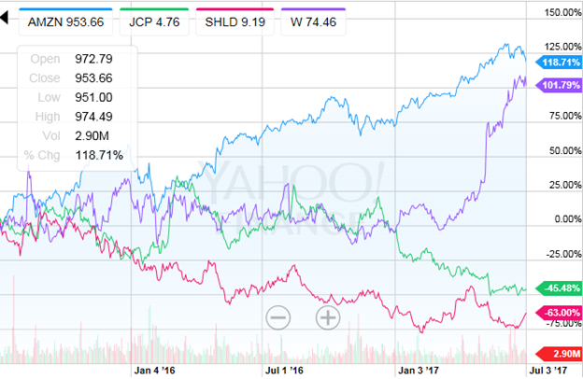
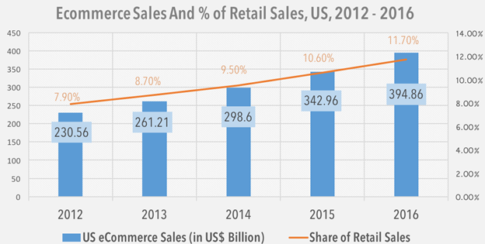
2017 has been an ugly year for traditional Brick-and-Mortar retailers who have been unsuccessful in creating an omnichannel strategy of both an in-person & digital shopping experience. Stores such as Sears and JcPenney, both once behemoths in the industry and household names for over a century, now face potential bankruptcy as large online players such as Amazon have been stealing market share. While Sears and JcPenney’s stock performance have significantly lagged the S&P, losing 45% and 63% over the last two years, e-commerce sites such as Amazon and Wayfair have seen their stock price double in the same timeframe. With E-commerce experiencing double digit growth, companies such as Walmart, have been strategically buying online technology platforms such as Jet.com and Shoebuy.com to capitalize on the growing E-commerce segment.
The Rise of E-Commerce & Fall of Brick-And-Mortar Retail
Source: U.S. Department of Commerce Publication 2/2017
Overview
Economic Conditions
Sector Review
Portfolio Strategy & Composition
Risk Analysis
Performance Review
Professor & Student Biographies

Slide 14
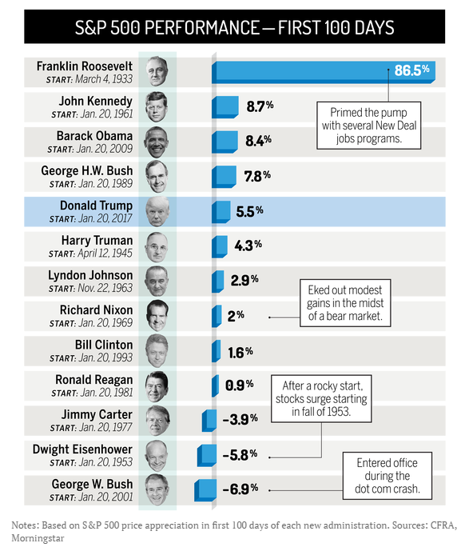

The Impact of Donald Trump’s Presidency
Donald Trump’s presidency is one of the most polarizing topics in recent times, with nearly every possible sector bracing for the ripple effects from his leadership choices. His words have stirred controversy in even the most apolitical fields, and markets are becoming conditioned to ride out the effects from his frequent Twitter outbursts. Controversial business decisions made by major corporations can send their stock plummeting if the President starts commenting, while other firms are trying to strategize as to what business decisions will need to be made based on the President’s evolving, and often confusing, intentions on immigration, infrastructure, trade, regulations, climate change, healthcare, and national security. The President’s use of social media and the extent of topics covered can impact markets faster than ever, opening the risk for market overreactions and future volatility.
Source: Time - Money
Overview
Economic Conditions
Sector Review
Portfolio Strategy & Composition
Risk Analysis
Performance Review
Professor & Student Biographies

Slide 15


The state of international relations in the United States have shifted since Donald Trump has become President. Donald Trump employees an “America First” approach to foreign policy. The United States is the leading contributor of funding to the UN, and President Trump is putting considerable pressure on the UN to reduce peacekeeping operations and slash spending. United Nations Secretary, General Antonio Guterres warned Donald Trump’s administration against isolating the United States from the rest of the world. Guterres stated that, “if the United States disengage in relation to many aspects of foreign policy and many aspects of international relations, it will be unavoidable that other actors will occupy that space.” Guterres also stated that he does not think the US disengaging from international relations is good for the United States or the rest of the world.
International Relations
Trump’s Withdrawal from International Relations
The U.S. withdrew from the Paris Climate Agreement
The U.S.’s participation in the Trans-Pacific Partnership was terminated
Trump instated a Travel Ban
Impact on relations with South Koreans and the Japanese due to discussions with North Korea
Threat to build the Mexican Border Wall
Questionable relations with Russia
Source: CNN
Overview
Economic Conditions
Sector Review
Portfolio Strategy & Composition
Risk Analysis
Performance Review
Professor & Student Biographies

Slide 16

Trade Policies & Regulations
Trade policy defines the laws related to the exchange of goods and services involved in trade between countries including taxes, regulations, and any subsidies or other agreements.
The President’s 2017 Trade Policy Agenda suggests a focus on maintaining a balanced policy that looks out for the interests of all segments of the U.S. economy, including manufacturing, agriculture, and services, as well as small businesses and entrepreneurs. In addition, the president plans to strictly enforce U.S. trade laws to prevent the U.S. market from being distorted by dumped and/or subsidized imports that harm domestic industries and workers.
There has been speculation that some of the president’s proposed policies could spark a “trade war”, yet other policies are viewed as a positive for the economy.
Source: CNN
Source: The Stand
Overview
Economic Conditions
Sector Review
Portfolio Strategy & Composition
Risk Analysis
Performance Review
Professor & Student Biographies

Slide 17
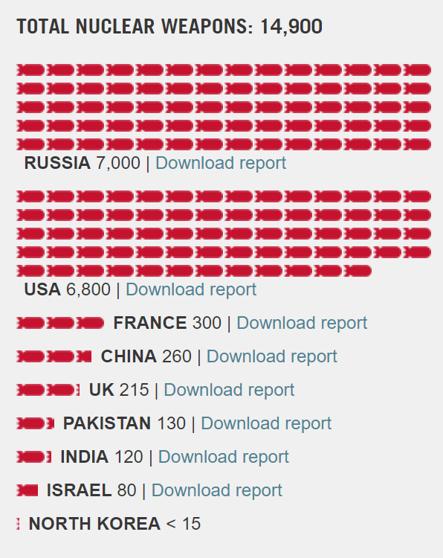
Security Concerns
Climate Change
A CIA-commissioned study by the National Research Council warned or unpredictable, climate change-induced crises occurring with increased frequency. Hurricane Sandy is an example of a crisis that affected public health systems as well as food, energy, water supplies and markets.
Nuclear Security
Fears of a nuclear-armed Iran and North Korea's recent nuclear tests are mounting as international relations are tested. On July 4, 2017, North Korea demonstrated its ability to hit Alaska with a nuclear missile.
Cyber Security
Attacks on the United State’s institutions and infrastructure are a growing problem in 2017.
Foreign Relations & Terrorism
The breakdown of the United States relations with the international community is adding increased tension to the world. This is coupled with the pre-existing concerns regarding terrorism around the globe.
Sources (Left to Right):
NASA Climate Change
The Cyber Advocate
The Imaginative Conservative
Nuclear Weapons Free Organization
Ploughshares Fund
Overview
Economic Conditions
Sector Review
Portfolio Strategy & Composition
Risk Analysis
Performance Review
Professor & Student Biographies
Notes:
The Cyber Advocate
Nasa Climate Change
Nuclear Weapons Free Organization
The Imaginative Conservative

Slide 18
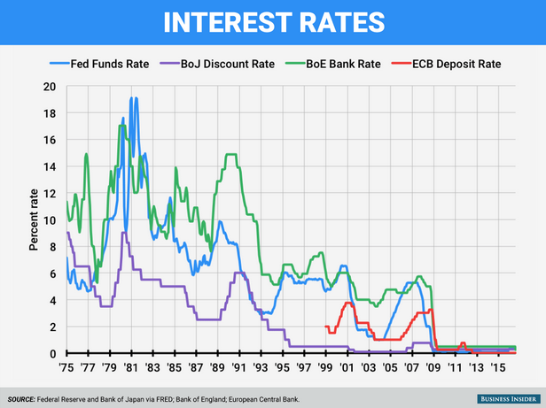
Policy makers in the United States, Europe, and Japan have cut rates dramatically in an effort to spur economic growth as a result of the great recession. The United States has recently decided to gradually raise rates, a decision that was implemented in the fourth quarter of 2015.
The low rate environment has led investors to seek yield in other sectors of the market, and allowed businesses to borrow at historically low rates for an extended period of time.
Worldwide Low Interest Rates
Overview
Economic Conditions
Sector Review
Portfolio Strategy & Composition
Risk Analysis
Performance Review
Professor & Student Biographies

Slide 19
SECTOR REVIEW

Slide 20
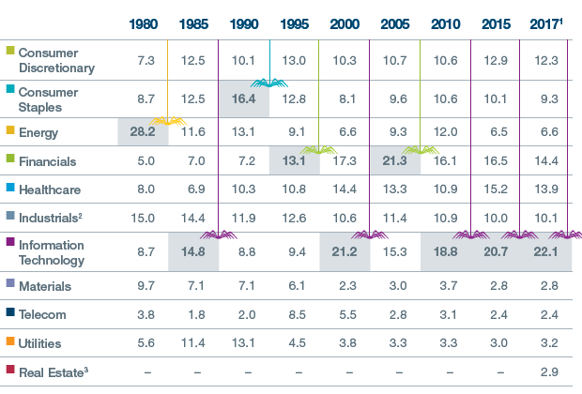
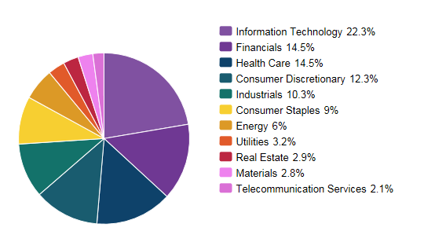
Sector Overview
The class voted on target portfolio weightings by S&P 500 sector during the first class session. The class then continued to review and refine these weightings during the course of the semester. The following is a discussion of recent performance in each sector, followed by a final analysis of sector weightings in the portfolio as of 6/30/2017.
Source: SPDR ETFs 6/30/17
Overview
Economic Conditions
Sector Review
Portfolio Strategy & Composition
Risk Analysis
Performance Review
Professor & Student Biographies

Slide 21
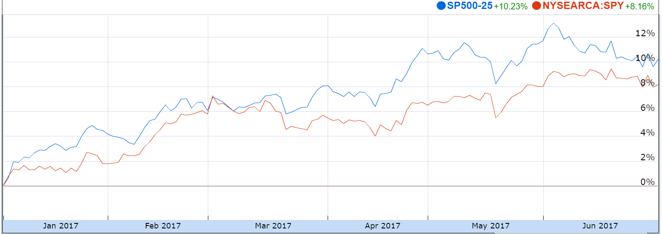
Consumer Discretionary
The Consumer Discretionary Sector is made up of industries and companies that sell non-essential goods and services and tend to be the most sensitive to economic cycles. The manufacturing segment includes automotive, textiles, apparel, luxury goods, and leisure equipment and products. The services segment includes hotels, restaurants and leisure facilities, media production and services, and consumer retailing and service. This sector tends to outperform in times of economic recovery and expansion because more cash is flowing into these companies via more discretionary spending as consumers have more cash in their pockets, but consumer spending has shifted away from traditional retailers into the pockets of e-commerce companies. Brick-and-mortar retail establishments have been weighing down the sector’s growth, as Macy’s, Kohl’s, Nordstrom’s, and J.C. Penney Co Inc. announced worse-than-expected sale drops this May, and department store sales have fallen 5.2% over a one year period.
Performance (YTD):
10.23%
Final Contribution vs. S&P:
Underweight
Portfolio Holdings:
Wal-Mart (WMT)
Comcast (CMCSA)
The Walt Disney Company (DIS)
Consumer Discretionary ETF (XLY)
Sources: SPDR ETFs & Google Finance
Overview
Economic Conditions
Sector Review
Portfolio Strategy & Composition
Risk Analysis
Performance Review
Professor & Student Biographies

Slide 22
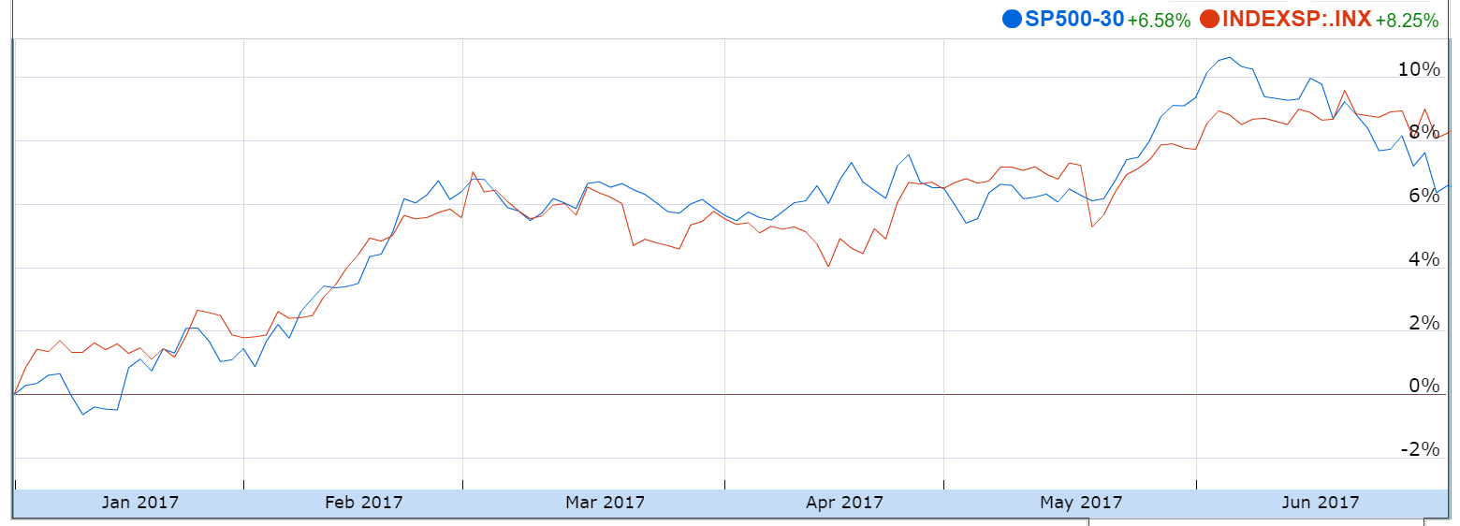
Consumer Staples
The Consumer Staples Sector includes companies whose operations are less sensitive to economic cycles. Some examples are manufacturers, food distributors, producers of tobacco, beverages, non-durable household goods, and personal products. The sector also comprises food and drug retailing companies, hypermarkets, and consumer super centers. The sector generally performs best during economic downturns. With the U.S. in a later-stage expansion, coupled with investors’ fears that the market is reaching its high point, increasing geopolitical tensions, and several key elections abroad, the short-term flight to safety could prove to be beneficial for the Consumer Staples sector. Conversely, if the spending capabilities improve for the U.S. economy as a whole, the returns for the Consumer Staples sector could be flattened or negative depending upon the magnitude of the policy implementations.
Performance (YTD):
6.58%
Final Contribution vs. S&P:
Underweight
Portfolio Holdings:
Procter & Gamble (PG)
Tyson Foods Inc (TSN)
Consumer Staples ETF (XLY)
Sources: SPDR ETFs & Google Finance
Overview
Economic Conditions
Sector Review
Portfolio Strategy & Composition
Risk Analysis
Performance Review
Professor & Student Biographies

Slide 23
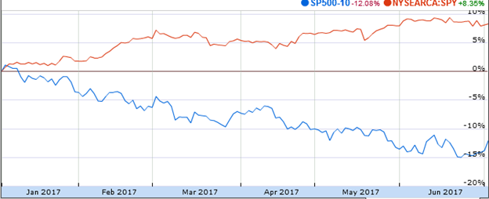
Energy
The Energy Sector is comprised not only of companies involved in the exploration, drilling, production, refining, storage, or management of energy resources, such as oil, gas, coal, and other consumable fuels but also firms which offer services or equipment to these industries. With the fall of oil and natural gas prices over the last several years, this sector has been performing poorly. Despite OPEC trying to curtail production, a stronger U.S. dollar and the rise of fracking in America will continue to depress energy prices in the near future. As a result, the class was underweight the energy sector.
Performance (YTD):
-12.08%
Final Contribution vs. S&P:
Underweight
Portfolio Holdings:
Valero Energy Corporation (VLO)
Energy ETF (XLE)
Sources: SPDR ETFs & Google Finance
Overview
Economic Conditions
Sector Review
Portfolio Strategy & Composition
Risk Analysis
Performance Review
Professor & Student Biographies

Slide 24
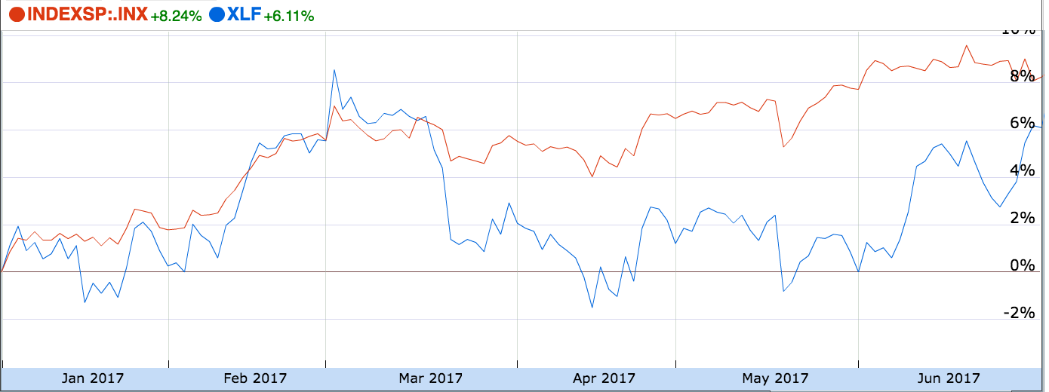
Financials
As defined by the Global Industry Classification Standard, the Financials Sector contains companies involved in banking, thrifts & mortgage finance, specialized finance, consumer finance, asset management and custody banks, investment banking and brokerage and insurance. The sector has benefited due to the rising interest rate environment, but due to several talks of breaking up big banks as well as tax reform that could be detrimental to the diversified banks’ performance, the sector largely has underperformed the S&P 500 on YTD basis. The sector vastly broke out following the 2016 presidential elections as Donald Trump’s policies were seen as favorable to the financial sector. However, with arguably the most tumultuous 100 days of his presidency, the President has been unable to move forward with much of deregulation causing the Financials sector to remain relatively flat compared to the S&P 500.
Performance (YTD):
6.11%
Final Contribution vs. S&P:
Overweight
Portfolio Holdings:
The PNC Financial Services Group Inc (PNC)
Blackstone Group (BX)
Financials ETF (XLF)
Sources: SPDR ETFs & Google Finance
Overview
Economic Conditions
Sector Review
Portfolio Strategy & Composition
Risk Analysis
Performance Review
Professor & Student Biographies

Slide 25
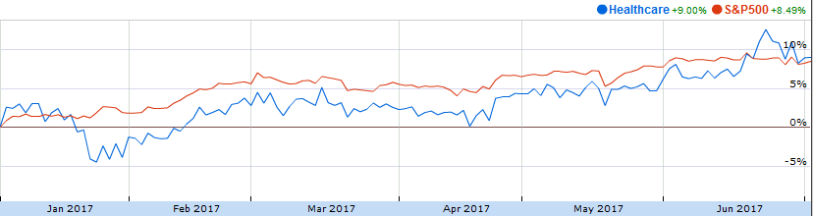
Healthcare
The Healthcare Sector encompasses two primary industry groups. The first is comprised of healthcare manufactures and healthcare service providers including operators of health care facilities. The second group is comprised of research, production, and marketing of pharmaceuticals and biotechnology related products. The key differentiator between a biotechnology company and a pharmaceutical company is the development of the drugs. Biotechnology companies rely on living organisms like bacteria whereas pharmaceuticals are developed with chemicals. The healthcare industry is currently awaiting the vote on the reformed healthcare law which, if passed, will have ramifications that last for years. Currently, without a finalized bill it will be too tough to assess what those ramifications will be, and how they will impact the state of the healthcare industry.
Performance (YTD):
9.00%
Final Contribution vs. S&P:
Underweight
Portfolio Holdings:
Allergan PLC (AGN)
Bristol Myers-Squibb (BMY)
Healthcare ETF (XLV)
Sources: SPDR ETFs & Google Finance
Overview
Economic Conditions
Sector Review
Portfolio Strategy & Composition
Risk Analysis
Performance Review
Professor & Student Biographies

Slide 26
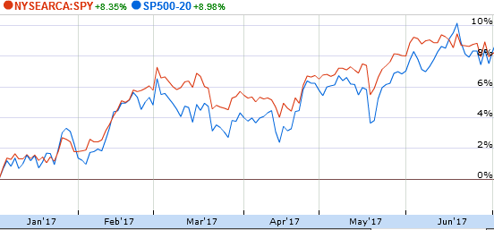
Industrials
The Industrials Sector of the S&P 500 consists of companies that manufacture and distribute capital goods, including aerospace & defense, construction, engineering & building products, electrical equipment and industrial machinery. The sector also provides commercial services and supplies, including printing, employment, environmental and office services. Industrials also provide transportation services, including airlines, couriers, marine, road & rail and transportation infrastructure. Performance in the industrial goods sector is largely driven by supply and demand for building construction, such as residential, commercial and industrial, as well as the demand for manufactured products. The sector has been doing well as low oil and gas prices have lowered costs for manufacturers and airline operators.
Performance (YTD):
8.98%
Final Contribution vs. S&P:
Overweight
Portfolio Holdings:
Stanley Black & Decker (SWK)
Delta Airlines (DAL)
Magna International (MGA)
Industrials ETF (XLI)
Sources: SPDR ETFs & Google Finance
Overview
Economic Conditions
Sector Review
Portfolio Strategy & Composition
Risk Analysis
Performance Review
Professor & Student Biographies

Slide 27
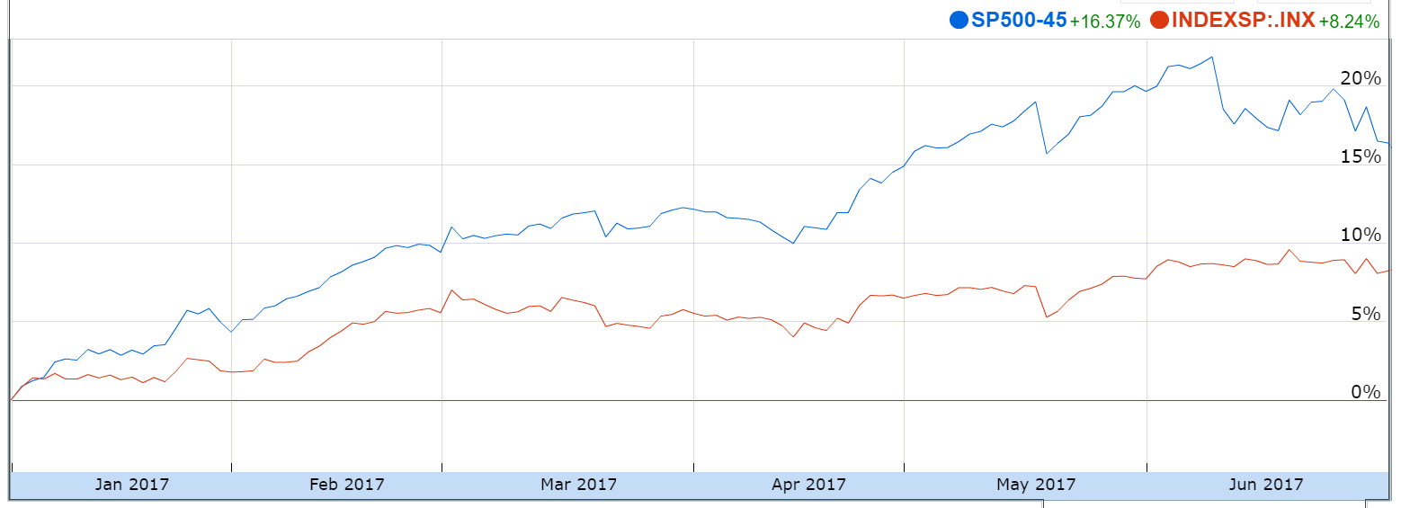
Information Technology
The Information Technology Sector covers a wide variety of businesses, the majority of which fall under four sub-sectors: (1) Internet, Software and Services, (2) Technology Hardware, Storage and Peripherals, (3) Semiconductors and (4) System Software. Information Technology also covers firms which provide data processing, IT consulting, communications equipment and general electronic components. The technology sector is unique because all other sectors can be impacted by the technology sector; all firms use technology in running their operations and feel current pressures to increase capital spending on connectivity, security, and efficiency improvements in order to stay competitive in the global market. These changes trigger higher demand for data storage capabilities, speed, and security. Remaining competitive in the tech sector means using the latest and greatest before other incumbents do the same, so we expect consistent growth for the foreseeable future as consumers and companies keep up with evolving needs and trends.
Performance (YTD):
16.37%
Final Contribution vs. S&P:
Underweight
Portfolio Holdings:
Adobe Systems Inc (ADBE)
Facebook (FB)
Stamps.com Inc (STMP)
The Hackett Group (HCKT)
Technology ETF (XLK)
Sources: SPDR ETFs & Google Finance
Overview
Economic Conditions
Sector Review
Portfolio Strategy & Composition
Risk Analysis
Performance Review
Professor & Student Biographies

Slide 28
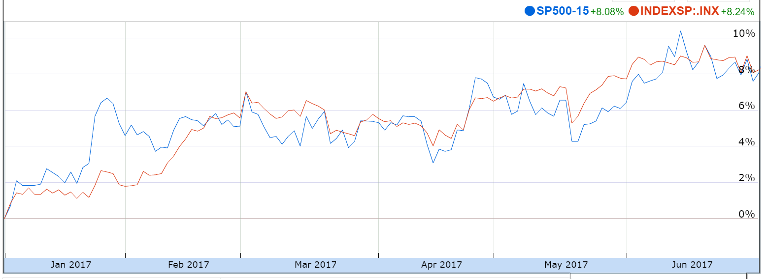
Materials
The Materials Sector includes a vast selection of commodity-related manufacturing industries. The sector is focused on companies which manufacture chemicals, forest and related packaging products, paper, construction materials, glass, metals, minerals, and mining companies, along with steel producers.
Performance (YTD):
8.08%
Final Contribution vs. S&P:
Overweight
Portfolio Holdings:
Dow Chemicals (DOW)
Materials ETF (XLB)
Sources: SPDR ETFs & Google Finance
Overview
Economic Conditions
Sector Review
Portfolio Strategy & Composition
Risk Analysis
Performance Review
Professor & Student Biographies

Slide 29
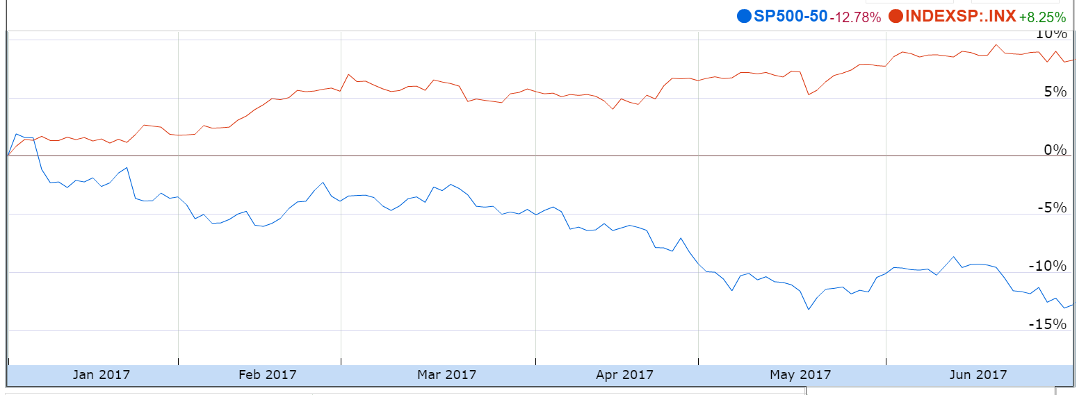
Telecommunications
The Telecommunications Sector consists of companies that provide communications and/or data services primarily through a fixed-line, cellular, wireless, high bandwidth and/or fiber optic cable network. These firms can also be engaged in the designing, building, and servicing of communications devices and networks. As a defensive market, telecom stocks tend to beat the S&P 500 during periods of recession. With current macroeconomic growth and rising interest rates projected, telecom could have a tough road ahead. Additionally, the amount of company debt (driven by the high capital costs required to build the infrastructure) commonly undertaken in telecom could present a problem when interest rates rise. Throughout 2017, the sector has not performed well relative to the S&P.
Performance (YTD):
-12.78%
Final Contribution vs. S&P:
Overweight
Portfolio Holdings:
Ubiquiti Networks Inc (UBNT)
Sources: SPDR ETFs & Google Finance
Overview
Economic Conditions
Sector Review
Portfolio Strategy & Composition
Risk Analysis
Performance Review
Professor & Student Biographies

Slide 30
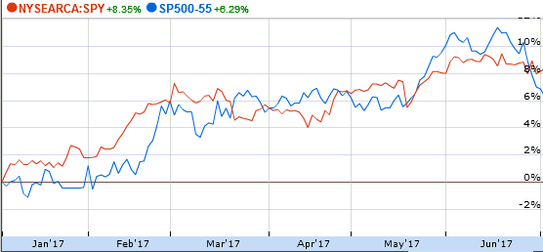
Utilities
The Utilities Sector is comprised of gas, electric and water companies, as well as integrated providers of energy. The largest firms in the sector by market capitalization tend to be power utilities. The utility sector is known as a defensive sector, as it has low correlation with other sectors and tends to outperform during market downturns. The industry traditionally pays higher dividends than other sectors. While the class started the semester underweight the sector, due to geopolitical risks and other factors, the class shifted its mindset to increasing its utility holdings as a hedge against a market downturn and a method to capture income from dividends.
Performance (YTD):
6.29%
Final Contribution vs. S&P:
Overweight
Portfolio Holdings:
Exelon Generation (EXC)
Utilities ETF (XLU)
Sources: SPDR ETFs & Google Finance
Overview
Economic Conditions
Sector Review
Portfolio Strategy & Composition
Risk Analysis
Performance Review
Professor & Student Biographies

Slide 31
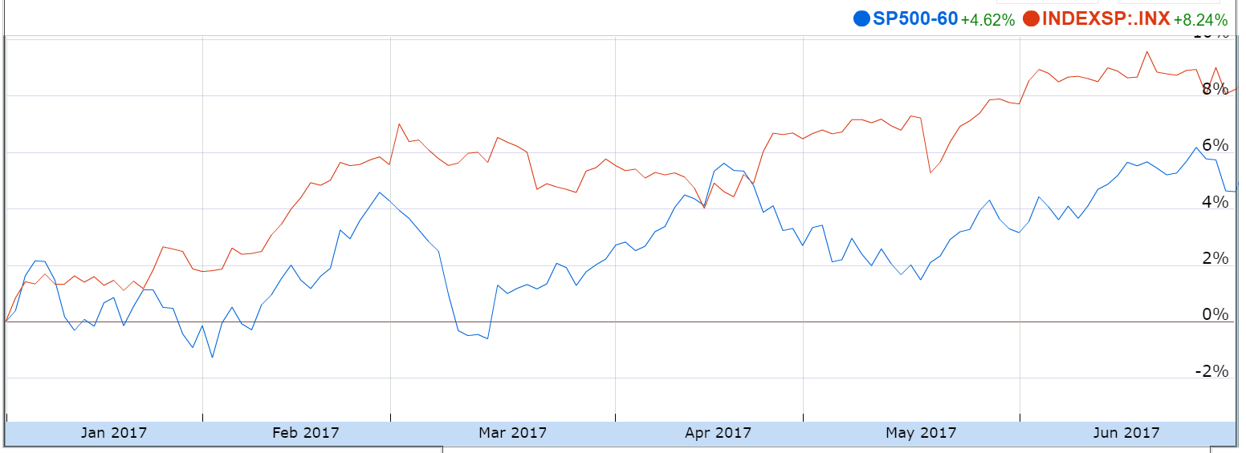
Real Estate
In August 2016, S&P and the Modern Index Strategy Indexes (MSCI) moved equity REITs and other listed real estate companies from the Financials sector into a new Real Estate Sector. The separation of sectors came about as the market started to realize how important real estate was and how much it has evolved over the years. A REIT is an investment vehicle that invests in real estate through property mortgages and is usually very liquid. These make up roughly 98% of the equity market capitalization in the real estate sector while brokerage companies make up the remainder. Two key attributes of REITs is the required payout of at least 90% of their income and the relative low volatility.
Performance (YTD):
4.62%
Final Contribution vs. S&P:
Overweight
Portfolio Holdings:
SL Green Realty Corp (SLG)
Real Estate ETF (XLRE)
Sources: SPDR ETFs & Google Finance
Overview
Economic Conditions
Sector Review
Portfolio Strategy & Composition
Risk Analysis
Performance Review
Professor & Student Biographies

Slide 32
PORTFOLIO STRATEGY & COMPOSITION

Slide 33
Portfolio Strategy & Composition Overview
As discussed earlier, the class pursued three different strategies in crafting the portfolio: growth, value, and dividend. The following slides discuss the screen criteria used for each strategy, as well as the recommendations made during the semester in each category. Finally, there is a brief overview of every holding in the portfolio as of 6/26/17 as well as positions closed during the semester.
Overview
Economic Conditions
Sector Review
Portfolio Strategy & Composition
Risk Analysis
Performance Review
Professor & Student Biographies

Slide 34
Growth Strategy Overview
Objective: To find stocks expected to grow faster than their industry peers.
BUY CRITERIA
Conservative Mentality | Expect Stock to Perform Better than the Industry
Revenue Growth | Industry Average and Forecasted to Continue to Grow
Strong Earnings | 5 years of CAGR
ROE | ≥ 15% and > Industry Average
PEG | ≤ 1.2 and < Industry Average
Debt/Equity | < 1.5 (or Acceptable Interest Coverage Ratio when D/E >1.0)
SELL CRITERIA
Price | Price Reaches 10% Below Target Price or 20% Above Purchase Price
Leadership | The Company’s Leadership Position Changes
Business Fundamentals | Business Fundamentals Deteriorate
Company Slowdown | Slowing Unit Volume, Revenue Decline, Weak Earnings, etc.
Alternative Investments | Superior Investment Alternatives are Identified
Overview
Economic Conditions
Sector Review
Portfolio Strategy & Composition
Risk Analysis
Performance Review
Professor & Student Biographies

Slide 35
Growth Strategy Overview (continued)
Stop Loss Criteria
Additions to Portfolio
Stop Loss criterion was set at 20% below the purchase price base if all the buy criteria were met. The class had the ability to adjust the stop loss point for additional risk. There was also consideration given to crawling/trailing stops to allow for profits as the stock price increased. No stop loss criterion was met during the Summer 2017 trading period.
Allergan PLC (AGN)
The Hackett Group (HCKT)
Ubiquiti Networks (UBNT)
Bristol Myers Squibb Company (BMY)
Tyson Foods Inc Class A (TSN)
Overview
Economic Conditions
Sector Review
Portfolio Strategy & Composition
Risk Analysis
Performance Review
Professor & Student Biographies

Slide 36
Growth Strategy Position Changes
Allergan PLC | AGN
Revenue Growth
5 years of CAGR
17.3%
ROE
16.78%
0.87
Debt/ Equity
0.19
Buy Criteria
Industry Average
AGN
18.86%
-
26.0%
16.63%
1.20
PEG
0.37
Position (Date Purchased: 05-25-2017)
55 Shares | $12,375.34
Allergan was founded in 1948 and is headquartered in Dublin, Ireland. They are a global pharmaceutical company and a leader in a new industry model – Growth Pharma.
They exemplify portfolio diversification, patent management, a background of M&A, and strong international sales growth (10.5%), with the China market alone growing at 42%.
Allergan is focused on developing, manufacturing and commercializing branded pharmaceutical, device, biologic, surgical and regenerative medicine products for patients around the world.
Overview
Economic Conditions
Sector Review
Portfolio Strategy & Composition
Risk Analysis
Performance Review
Professor & Student Biographies

Slide 37
Growth Strategy Position Changes
The Hackett Group | HCKT
Revenue Growth
5 years of CAGR
9.3%
ROE
14.3%
-
Debt/ Equity
1.3
Buy Criteria
Industry Average
HCKT
6.7%
12.0%
7.5%
25.5%
0.9
PEG
0.1
Position (Date Purchased: 05-25-2017)
640 Shares | $9,582.80
The Hackett Group was founded in 1991. They were acquired by Answerthink, Inc. in 1997, which was renamed The Hackett Group in 2008. They have global offices in the US, Europe, and Asia/Pacific region.
Recently, they have had several acquisitions and a joint partnership with Symphony Ventures to tap into the robotics process automation space.
Intellectual property-based strategic consultancy and best practices implementation firm. They provide services in business transformation, enterprise performance management, working capital management, global business services, and operations, finance, human capital management, and IT support.
Overview
Economic Conditions
Sector Review
Portfolio Strategy & Composition
Risk Analysis
Performance Review
Professor & Student Biographies

Slide 38

Growth Strategy Position Changes
Ubiquiti Networks | UBNT
Revenue Growth
5 years of CAGR
9.0%
ROE
7.4%
-
Debt/ Equity
0.5
Buy Criteria
Industry Average
UBNT
27.6%
12.2%
27.5%
52.2%
0.7
PEG
0.4
Position (Date Purchased: 06-09-2017)
275 Shares | $14,058.24
Founded in 2005, Ubiquiti Networks Inc provides wireless and wireline network equipment for small Internet service providers and small- and midsize-business integrators. They focus on underserved and emerging markets.
Their success can be attributed to their business model, which includes disruptive pricing, frugal cost-controls, and little administrative structure. Recently, they have had share buybacks, expansion into brick and mortar stores, and continued R&D investment.
Overview
Economic Conditions
Sector Review
Portfolio Strategy & Composition
Risk Analysis
Performance Review
Professor & Student Biographies

Slide 39
Growth Strategy Position Changes
Bristol Myers Squibb Company | BMY
Revenue Growth
13.0%
ROE
16.2%
-
Debt/ Equity
0.6
Buy Criteria
Industry Average
BMY
-1.6%
11.8%
33.6%
1.4
PEG
0.5
5 years of CAGR
5.8%
Position (Date Purchased: 06-16-2017
185 Shares | $9,931.93
Founded in 1887, Bristol-Myers Company merged with Squibb in 1989. They are headquartered in New York City with facilities in Asia, Europe, and North America.
Manufacturer of therapeutic prescription pharmaceuticals, Cancer, HIV/AIDS, cardiovascular disease, diabetes, hepatitis, rheumatoid arthritis and psychiatric disorders.
Unique BioPharma strategy that leverages the reach and resources of a major pharma company aligned with the entrepreneurial spirit and agility of a biotech firm.
Overview
Economic Conditions
Sector Review
Portfolio Strategy & Composition
Risk Analysis
Performance Review
Professor & Student Biographies

Slide 40
Growth Strategy Position Changes
Tyson Foods Inc | TSN
Revenue Growth
5 years of CAGR
9.70%
ROE
22.89%
2.56
Debt/ Equity
0.6
Buy Criteria
Industry Average
TSN
1.90%
-2.17%
2.90%
18.48%
1.67
PEG
0.6
Position (Date Purchased: 06-20-2017)
165 Shares | $10,137.32
Founded in 1932 and headquartered in Springdale, Arkansas. Tyson Foods Inc processes and distributes value-added beef, chicken pork, prepared foods and related allied products, including animal and pet food ingredients. Its product brands are Wright, Jimmy Dean, Hillshire Farm, Ball Park and Sara Lee.
Their strengths lie in quality of products, diversification, acquisitions, and large potential growth in the prepared food segments.
Overview
Economic Conditions
Sector Review
Portfolio Strategy & Composition
Risk Analysis
Performance Review
Professor & Student Biographies

Slide 41
Value Strategy Overview
Objective: To find stocks priced less than their intrinsic value.
BUY CRITERIA
Price/Sales | < Industry Average
Price/Book | < Industry Average
Dividends | > Industry Average
Free Cash Flow | Positive
SELL CRITERIA
Mergers or Acquisitions | Any News Regarding M&A Activity
Earnings | Significant Restatement
Executive Management | Changes to Management
Price Targets | Exceeds Initial Price Target
Price | Trending Downwards Towards a Stop Loss Mark
Overview
Economic Conditions
Sector Review
Portfolio Strategy & Composition
Risk Analysis
Performance Review
Professor & Student Biographies

Slide 42
Value Strategy Overview (continued)
Stop Loss Criteria
Additions to Portfolio
Stop Loss criterion was set at 20% below the purchase price base if all the buy criteria were met. The class had the ability to adjust the stop loss point for additional risk. There was also consideration given to crawling/trailing stops to allow for profits as the stock price increased. No stop loss criterion was met during the Summer 2017 trading period.
Procter & Gamble (PG)
Valero Energy Corp (VLO)
Walmart (WMT)
Overview
Economic Conditions
Sector Review
Portfolio Strategy & Composition
Risk Analysis
Performance Review
Professor & Student Biographies

Slide 43

Value Strategy Position Changes
Procter & Gamble (PG)
Price/Sales
Price/Book
6.8
Dividend Yield
2.6%
-
Buy Criteria
Industry Average
PG
3.7
2.8
4.28
3.1%
$12,121M
Positive FCF
Position (Date Purchased: 06-20-2017)
175 Shares | $15,721.39
Procter & Gamble was founded in 1837 by William Procter and James Gamble and is now headquartered in Cincinnati Ohio. The joint venture was born nearly out of necessity. The son in laws each owned and operated their own business. Procter a candle maker and Gamble a soap maker were consuming the same raw materials, their joint venture began with total assets of $7,192.24, Today P&G is a leading consumer goods corporation with 105,000 employees and generating in over $65B in revenue annually.
Recently P&G increased their divided by 3%. On May 26 2017 Morningstar recommend P&G as one of stocks it saw that would thrive in a market plagued with volatility. P&G has moved forward with a variety of cost-cutting initiative and is divesting from its unprofitable brands.
Overview
Economic Conditions
Sector Review
Portfolio Strategy & Composition
Risk Analysis
Performance Review
Professor & Student Biographies

Slide 44
Value Strategy Position Changes
Valero Energy Corp (VLO)
Price/Sales
Price/Book
1.9
Dividend Yield
3.6%
-
Buy Criteria
Industry Average
VLO
0.4
0.4
1.5
3.9%
$3,542M
Positive FCF
Position (Date Purchased: 06-02-2017)
225 Shares | $14,033.47
Valero Energy Corp. was founded in 1980 and is headquartered in San Antonio Texas. VLO is the world largest independent refiner. It operates 15 refineries producing 3.1 million barrels per day. With market cap of $30 billion VLO employees approximately 10,000 people. VLO is also one of Americas largest Ethanol producers with 11 plants generating 1.4 billion gallons per year.
Valero has reiterated its desire to return capital to share holders through dividend and buybacks. Further with expectations of an increase in supply of light crude off the gulf cost, VLO anticipates a sustainable long-term discount for its feed stock into its refineries. Given the current political climate deregulation is also anticipated which would benefit VLO.
Overview
Economic Conditions
Sector Review
Portfolio Strategy & Composition
Risk Analysis
Performance Review
Professor & Student Biographies

Slide 45

Value Strategy Position Changes
Walmart (WMT)
Price/Sales
Price/Book
3.4
Dividend Yield
2.3%
-
Buy Criteria
Industry Average
WMT
0.5
0.5
3.1
2.7%
$20,911M
Positive FCF
Position (Date Purchased: 05-25-2017)
170 Shares | $13,339.47
Walmart Stores, Inc. was founded on October 31, 1969 by Sam Walton and is headquartered in Bentonville, Arkansas.
Walmart's Focus is to achieve higher sales volumes by keeping prices lower than competitors
Walmart's key management is tenured, the firm has maintained its founding principals while adjusting to the evolving retail environment. In the last 18 months Wal-Mart has engaged in a multitude of M&A with a primary focus on eCommerce. Walmart’s eCommerce grew by 69% YOY in Q1 2017. While Amazon is seen as one if its biggest threats, Walmart continues to look for ways to differentiate itself while leveraging the world largest retail footprint with over 11,695 store world wide.
Overview
Economic Conditions
Sector Review
Portfolio Strategy & Composition
Risk Analysis
Performance Review
Professor & Student Biographies

Slide 46
Dividend Strategy Overview
Objective: To find stocks fairly priced and offering a dividend yield greater than the S&P 500.
BUY CRITERIA
Dividend Yield | ≥ SPDR S&P Dividend ETF
Quick Ratio | ≥ Industry Average
Cash Dividends | Positive Total Cash Dividends Paid Annually
Positive Total Cash | From Investing & Operating Activities
Constant Dividend | Yes
Dividend Growth | Historical & Potential Dividend Growth
SELL CRITERIA
Dividends | Dividends Are Cut
Free Cash Flow | Diminishes or is No Longer Positive
Alternative Investments | Superior Investment Alternatives are Identified
Overview
Economic Conditions
Sector Review
Portfolio Strategy & Composition
Risk Analysis
Performance Review
Professor & Student Biographies

Slide 47
Dividend Strategy Overview (continued)
Stop Loss Criteria
Additions to Portfolio
Stop Loss criterion was set at 20% below the purchase price base if all the buy criteria were met. The class had the ability to adjust the stop loss point for additional risk. There was also consideration given to crawling/trailing stops to allow for profits as the stock price increased. No stop loss criterion was met during the Summer 2017 trading period.
Blackstone Group (BX)
Exelon Corporation (EXC)
SL Green Realty Corp (SLG)
Overview
Economic Conditions
Sector Review
Portfolio Strategy & Composition
Risk Analysis
Performance Review
Professor & Student Biographies

Slide 48

Dividend Strategy Position Changes
The Blackstone Group (BX)
Div Yield ≥ SPDR Div ETF
Quick Ratio > Industry Average
1.1
Total Cash Div Paid Annually
-
-
Constant Dividend
-
Buy Criteria
BX
3.5%
1.0
Yes
Yes
Positive Cash Flow
Yes
Historical & Potential Div Growth
Yes
2.53%
Industry Average
Position (Date Purchased: 05-25-2017)
470 Shares | $15,284.43
The Blackstone Group was founded in 1985 by Stephen A. Schwarzman Chairman and Chief Executive Officer, and Peter G. Peterson, with a balance sheet of $400,000. It became the largest independent alternative asset management in 1993 and completed first IPO listing on NYSE in 2007. The Blackstone Group is one of the largest institutional owners of single-family homes.
Recently BX made a $100 billion infrastructure investment anchored by Saudi Arabia’s Public Investment Fund. In April of 2017, BX increased their dividend and on March 2, 2017 the firm received a 13 awards including Firm of the year (Global), Deal of the year (Global), Firm of the Year (North America, Europe, Germany, and Australia).
Overview
Economic Conditions
Sector Review
Portfolio Strategy & Composition
Risk Analysis
Performance Review
Professor & Student Biographies

Slide 49

Dividend Strategy Position Changes
Exelon Corporation (EXC)
Div Yield ≥ SPDR Div ETF
Quick Ratio > Industry Average
0.3
Total Cash Div Paid Annually
-
-
Constant Dividend
-
Buy Criteria
EXC
3.53%
0.8
Yes
Yes
Positive Cash Flow
Yes
Historical & Potential Div Growth
Yes
2.53%
Industry Average
Position (Date Purchased: 06-09-2017)
385 Shares | $14,325.85
Exelon's family of companies represents every stage of the energy value chain. Exelon’s six utilities deliver electricity and natural gas to approximately 10 million customers in Delaware, the District of Columbia, Illinois, Maryland, New Jersey and Pennsylvania through their Atlantic City Electric, BGE, ComEd, Delmarva Power, PECO and Pepco subsidiaries. Exelon Generation is one of the largest competitive U.S. power generators and has approximately 32,700 megawatts of nuclear, gas, wind, solar and hydroelectric generating capacity comprising one of the nation's cleanest, lowest-cost power generation fleets. Constellation provides energy products and services to approximately 2 million residential, public sector and business customers, including more than two-thirds of the Fortune 100. Exelon does business in 48 states, D.C., and Canada and had 2016 revenues of $31.4 billion. They employ approximately 34,000 people nationwide.
Overview
Economic Conditions
Sector Review
Portfolio Strategy & Composition
Risk Analysis
Performance Review
Professor & Student Biographies

Slide 50

Dividend Strategy Position Changes
SL Green Realty Corp (SLG)
Div Yield ≥ SPDR Div ETF
Quick Ratio > Industry Average
0.2
Total Cash Div Paid Annually
-
-
Constant Dividend
-
Buy Criteria
SLG
2.82%
1.38
Yes
Yes
Positive Cash Flow
Yes
Historical & Potential Div Growth
Yes
2.53%
Industry Average
Position (Date Purchased: 6-20-2017)
100 Shares | $10,494.52
SL Green Realty Corp. was Founded in 1980 by Stephen L. Green. Since its 1997 IPO SLG has experienced remarkable growth. When the firm went public, the portfolio consisted of six properties totaling 1.2 million sq-ft. Today, SL Green is an S&P 500 company and New York City's largest office landlord, with an equity market capitalization of approximately $11 billion,
SLG focuses on High end Class A office property's in Manhattan and the greater New York City area. SLG also has high end retail tenants, a segment that is thriving despite the pressures on many other brick and mortar retailers.
Overview
Economic Conditions
Sector Review
Portfolio Strategy & Composition
Risk Analysis
Performance Review
Professor & Student Biographies

Slide 51
Strategy Allocation
Strategy | Market Value | % of Portfolio | Sector
Growth | $119,574.38 | 20.74%
Ubiquiti Networks Inc. | $14,042.88 | 2.44% | Telecommunications
Allergan PLC | $13,687.85 | 2.37% | Health Care
Bristol-Myers Squibb | $10,546.85 | 1.83% | Health Care
Tyson Foods Inc Cl A | $10,355.40 | 1.80% | Consumer Staples
The Hackett Group | $9,843.20 | 1.71% | Information-Technology
Value | $167,329.87 | 29.03%
Procter & Gamble | $15,666.00 | 2.72% | Consumer Staples
Valero Energy Corp | $14,922.00 | 2.59% | Energy
Wal-Mart | $12,858.80 | 2.23% | Consumer Discretionary
Dividend | $40,589.73 | 7.04%
Blackstone Group | $15,561.70 | 2.70% | Financials
Exelon Corp | $14,347.03 | 2.49% | Utilities
SL Green Realty Corp | $10,681.00 | 1.85% | Real Estate
Overview
Economic Conditions
Sector Review
Portfolio Strategy & Composition
Risk Analysis
Performance Review
Professor & Student Biographies

Slide 52
ETF Exposure
SPDR Sector ETF
Weight
Performance
Consumer Staples ETF (XLP)
Energy ETF (XLE)
Financials ETF (XLF)
9.85
3.51
Consumer Discretionary ETF (XLY)
3.29
6.11
6.01
3.44
-10.66
3.48
13.59
Health Care ETF (XLV)
2.05
Highlighted to the right are the weightings and the accompanying performance of the sector ETF’s in the portfolio.
Key Contributors
Health Care: (Low Valuations, Strong Balance Sheet, Obamacare Likely Intact)
Technology: (Increased Technology CAPEX, Strong M&A, Low-Debt Companies)
Key Detractors
Financials: (Dip in Company Yields, Flattening of Yield Curve, No Regulatory Changes)
Energy: (African Production Increase, Use Restrictions, Low Oil Prices)
Technology ETF (XLK)
Materials ETF (XLB)
Real Estate ETF (XLRE)
2.00
2.58
Industrials ETF (XLI)
5.94
7.87
11.44
5.89
4.03
6.78
10.96
Utilities ETF (XLU)
2.82
Overview
Economic Conditions
Sector Review
Portfolio Strategy & Composition
Risk Analysis
Performance Review
Professor & Student Biographies

Slide 53
Unique Attributes
The following slides highlight unique attributes of each investment held in the Sellinger Applied Portfolio as of June 26, 2017.
Overview
Economic Conditions
Sector Review
Portfolio Strategy & Composition
Risk Analysis
Performance Review
Professor & Student Biographies

Slide 54
Unique Attributes
Allergan PLC (AGN)
Bristol-Myers Squibb Company (BMY)
A leading pharmaceutical company in immuno-oncology, BMY researches, develops and manufactures therapeutic prescription drugs to help patients prevail over serious disease. Recognized as one of the world’s most innovative companies in 2016 and in the top ten most innovative biotech firms.
Tyson Foods Inc (TSN)
Tyson Foods produces approximately 1 in 5 pounds of chicken, beef, and pork in the U.S. and contains many of the best brands in the business. FY16 finished as the best year ever with 26% YOY growth in adjusted operating income and 39% YOY growth in adjusted EPS with a 2017 outlook continuing this trend.
The Hackett Group, Inc (HCKT)
An established, global enterprise consulting firm for major corporations and government agencies that drives business transformation through best practices and operational excellence from technology investments. This company is positioned to capitalize on infrastructure services and emerging technologies.
A global pharmaceutical company developing innovative products for unmet medical needs. AGN has strong top-line growth and margins, and a diversified product offering with leading global brands that are protected by a strong patent portfolio.
Ubiquiti Networks Inc (UBQT)
A young, undervalued IT company that is disrupting the industry by producing high-performance, low-cost products so wireless networking can be a reality for everyone.
Overview
Economic Conditions
Sector Review
Portfolio Strategy & Composition
Risk Analysis
Performance Review
Professor & Student Biographies

Slide 55
Unique Attributes
Valero Energy Corp (VLO)
Wal-Mart Stores Inc (WMT)
The Blackstone Group (BX)
A leading global, diversified investment firm creating returns for investors and securing retirement for millions. This company is positioned for future industrial infrastructure upgrades. Dividends paid every year since its 2007 IPO with increases for the past four years.
Exelon Corp (EXC)
A diversified Energy Company with operations in conventional and renewable power generation, utilities, and supply. Exelon serves more than two-thirds of the Fortune 100 companies and is the only utility company in the Fortune 100 and delivered 3.6% dividend yield and 32.8% total shareholder return in 2016, when natural gas prices reached their lowest levels since 1999.
The Procter & Gamble Company (PG)
A consumer products giant with leading brand name recognition globally. PG has simplified its product lineup and streamlined operations to improve cash flow and profitability. Dividends increased by 3% for 61 consecutive years of dividend increases.
The world’s largest independent refinery and leading ethanol producer. Since 2011 VLO has returned capital to shareholders through an 18% reduction of outstanding shares and a 300% increase in quarterly dividends.
Retail innovator Sam Walton created a chain of discount stores that today is the largest retailer in the world with in-store sales growth of 3% and online sales of +63% YOY. E-commerce investments and an established supply chain make it best positioned to compete with Amazon.
Overview
Economic Conditions
Sector Review
Portfolio Strategy & Composition
Risk Analysis
Performance Review
Professor & Student Biographies

Slide 56
Unique Attributes
Facebook (FB)
Stamps.com Inc (STMP)
The PNC Financial Services Group (PNC)
One of the largest diversified financial services companies in the U.S. with longevity and a consistent operating history.
Delta Airlines (DAL)
One of the best-managed airlines with the highest operating margins among U.S. network carriers, Delta remains committed to returning 70% of its free cash flow to investors. DAL maintains the oldest fleet at over 16 years on average with low capital costs but high maintenance and fuel costs, which aligns well with the current low oil prices.
SL Green Realty Corp (SLG)
A Real Estate Investment Trust specializing in high quality commercial and high-end retail properties in Manhattan and Suburban areas. SLG has achieved EPA and Sustainable REIT recognition. One-year dividend growth of 13.26% and high property occupancy rates will provide consistent dividend income.
With 1.49 billion active users, the number of people using Facebook exceeds the population of China.
An internet-based mailing and shipping solution provider that is integrated in over 400 e-commerce marketplaces and online stores including eBay, PayPal, and Amazon. A small growth stock with large capabilities, STMP supports USPS and over 40 parcel carriers with over 20 million potential customers STMP printed $5.5B in postage in FY16.
Overview
Economic Conditions
Sector Review
Portfolio Strategy & Composition
Risk Analysis
Performance Review
Professor & Student Biographies

Slide 57
Unique Attributes
Magna International (MGA)
Comcast (CMCSA)
The Walt Disney Company (DIS)
A world leader in the entertainment industry with high brand loyalty and diversified products and services. DIS parks and resorts number of visitors are unmatched by its competitors.
Adobe Systems Inc (ADBE)
A strong brand that successfully transformed from desktop to cloud computing, Adobe is the only company that provides an integrated solution of content creation with advertising and marketing management. ADBE has increased its subscribers by 30%, providing a recurring and highly predictable revenue stream and 22% growth in 2016.
Stanley Black & Decker (SWK)
The company is the #1 supplier of power and hand tools in the world and the second largest U.S. supplier of commercial electronic security devices.
One of the largest most diversified auto-parts suppliers in the world that prides itself on its entrepreneurial culture. MGA has 321 manufacturing operations and 102 product development, engineering and sales centers in 29 countries.
A media and technology company with a network advantage, Comcast is the only carrier able to provide pay television, internet access, and phone services in almost 50% of its service area with a network platform that should meet customer demands far into the future.
Dow Chemicals (DOW)
One of the world’s largest chemical and materials companies with products and solutions serving automotive, agriculture, industrial, construction, health care, and consumer industries. The Dow-DuPont merger should close in Aug-17 with the entity preparing for a split into 3 separate companies: agriculture, material science and specialty products, producing long-term value.
Overview
Economic Conditions
Sector Review
Portfolio Strategy & Composition
Risk Analysis
Performance Review
Professor & Student Biographies

Slide 58
Sector Allocation
Industrials | 14.92%
Delta Airlines | 3.32%
Stanley Black & Decker | 2.86%
Magna International | 2.80%
Industrials ETF | 5.94%
Information-Technology | 20.21%
Facebook | 5.88%
Stamps.com Inc New | 4.72%
Adobe Systems Inc | 2.01%
The Hacket Groupp | 1.71%
Technology ETF | 5.89%
Materials | 4.60%
Dow Chemicals | 1.78%
Materials ETF | 2.82%
Real Estate | 3.85%
SL Green Realty Corp | 1.85%
Real Estate ETF | 2.00%
Telecommunications | 2.44%
Ubiquiti Networks Inc | 2.44%
Utilities | 5.07%
Exelon Corp | 2.49%
Utilities ETF | 2.58%
Cash | 1.82%
Consumer Discretionary | 10.77%
Comcast | 2.77%
The Walt Disney Company | 2.48%
Wal-Mart | 2.23%
Consumer Discretionary ETF | 3.29%
Consumer Staples | 7.95%
Procter & Gamble | 2.72%
Tyson Foods Inc Cl A | 1.80%
Consumer Staples ETF | 3.44%
Energy | 4.64%
Valero Energy Corp | 2.59%
Energy ETF | 2.05%
Financials | 16.02%
The PNC Financial Services Group, Inc | 3.47%
Blackstone Group | 2.70%
Financials ETF | 9.85%
Healthcare | 7.72%
Allergan PLC | 2.37%
Bristol Myers - Squibb | 1.83%
Health Care ETF | 3.51%
Overview
Economic Conditions
Sector Review
Portfolio Strategy & Composition
Risk Analysis
Performance Review
Professor & Student Biographies

Slide 59
Full Liquidations
During the Summer 2017, the class voted to liquidate positions within the portfolio. These positions were closed if the future outlook for the position was deemed unfavorable. The proceeds were reallocated to new, superior investments identified by the class with the target sector goals in mind.
Michael Kors Holdings Ltd (KORS)
Sold 260 shares at $36.87 on 5/31/17
CVS Health Corp (CVS)
Sold 191.153 shares at $76.24 on 5/31/17
BOFI Holding Inc (BOFI)
Sold 350 shares at $22.18 on 5/31/17
Vanguard Telecom Services ETF (VOX)
Sold 151.282 shares at $95.40 on 6/14/17
Ford Motor Company (F)
Sold 810.681 shares at $11.08 on 6/14/17
Akorn Inc (AKRX)
Sold 495 shares at $33.47 on 6/21/17
Overview
Economic Conditions
Sector Review
Portfolio Strategy & Composition
Risk Analysis
Performance Review
Professor & Student Biographies

Slide 60
Partial Liquidations
During the Summer 2017, the class voted to liquidate positions within the portfolio. These positions were partially liquidated if the future outlook for the position was deemed unfavorable. The proceeds were reallocated to new, superior investments identified by the class with the target sector goals in mind.
Consumer Staples SPDR ETF (XLP)
Sold 350 shares at $56.34 on 5/31/17
Sold 300 shares at $56.10 on 6/23/17
Remaining Balance of 355.318 Shares
Energy SPDR ETF (XLE)
Sold 220 shares at $65.16 on 6/7/17
Sold 250 shares at $64.98 on 6/23/17
Remaining Balance of 184.011 Shares
Overview
Economic Conditions
Sector Review
Portfolio Strategy & Composition
Risk Analysis
Performance Review
Professor & Student Biographies

Slide 61
RISK ANALYSIS

Slide 62
Risk Analysis Overview
The following section details the risk profile of the portfolio as of 6/26/17. Risk measures discussed include correlation, beta and covariance, value-at-risk, and tracking error.
Overview
Economic Conditions
Sector Review
Portfolio Strategy & Composition
Risk Analysis
Performance Review
Professor & Student Biographies

Slide 63
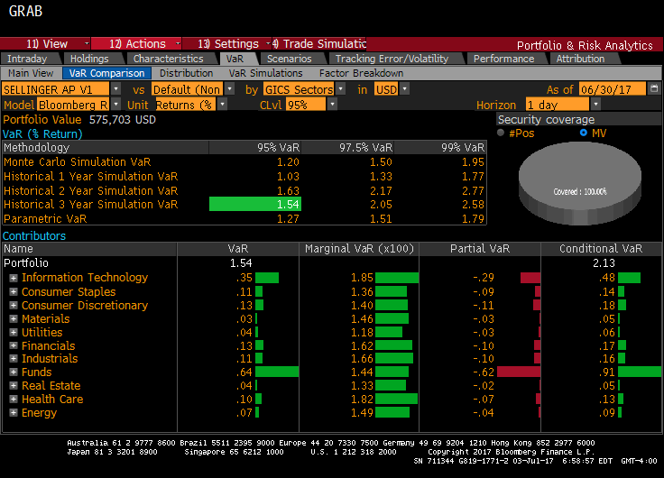
Value-at-Risk
A measure of the level of risk in a portfolio over a specific time frame.
The Bloomberg VaR Analysis (Monte Carlo Simulation) of our portfolio shows a potential % loss of the following over a one day time period:
120 bps potential loss at 95% VaR probability
150 bps potential loss at 97.5% VaR probability
195 bps potential loss at 99% VaR probability
The Parametric 1-day VaR shows a maximum potential 1-day loss as following:
127 bps potential loss at 95% VaR probability
151 bps potential loss at 97.5% probability
179 bps potential loss at 99% VaR probability
Overview
Economic Conditions
Sector Review
Portfolio Strategy & Composition
Risk Analysis
Performance Review
Professor & Student Biographies

Slide 64
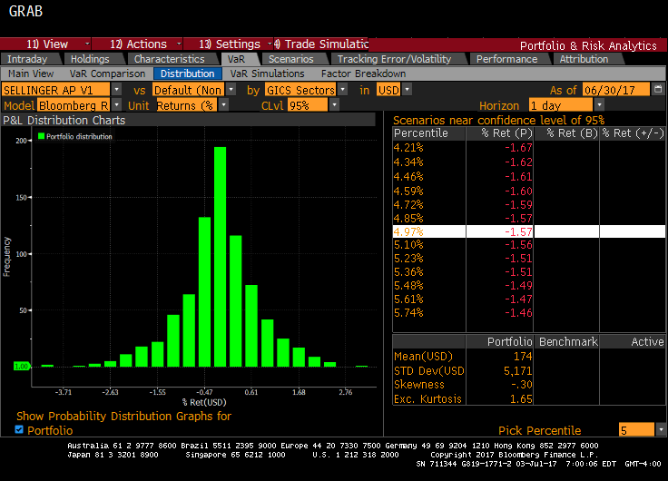
Monte Carlo Simulation
Our Monte Carlo Simulation shows near 95% confidence levels, the expected VaR returns for positions in the SAP portfolio over a one day time horizon.
Mean: -0.47%
Std. Dev.: 1.08%
On any given day, we expect our returns to be between -1.55% and 0.61% within one standard deviation
On any give day, we expect our returns to be between -2.63% and 1.68% within two standard deviations.
Overview
Economic Conditions
Sector Review
Portfolio Strategy & Composition
Risk Analysis
Performance Review
Professor & Student Biographies

Slide 65
Beta & Covariance
A measure of systematic risk, volatility, and return deviations.
Highest Return Given Lowest Beta: STMP, XLU, & TSN
Lowest Return Given Highest Beta: MGA, BX, & XLB
Portfolio Beta: 0.894
*Total Return as of 7/5/2017
Overview
Economic Conditions
Sector Review
Portfolio Strategy & Composition
Risk Analysis
Performance Review
Professor & Student Biographies

Slide 66
Correlation Matrix
SPY correlation is included in the correlation matrix but is not reflective of the statistical analysis output. SPY was used as a benchmark.
">0"
"0-0.39"
"0.4-0.69"
">0.7"
A measure of position returns and their linear relationships to one another.
 | WMT | CMCSA | DIS | XLY | XLP | PG | TSN | VLO | XLE | PNC | BX | XLF | XLV | BMY | AGN | XLI | DAL | SWK | MGA | XLK | ADBE | STMP | FB | HCKT | XLB | DOW | XLRE | SLG | UBNT | XLU | EXC | SPY
WMT
CMCSA | 0.11
DIS | 0.14 | 0.43
XLY | 0.27 | 0.57 | 0.5
XLP | 0.4 | 0.23 | 0.12 | 0.4
PG | 0.05 | 0.16 | 0.09 | 0.19 | 0.64
TSN | -0.03 | 0.05 | 0.2 | 0.12 | 0.31 | 0.26
VLO | 0.02 | -0.02 | 0.13 | 0.2 | 0.09 | 0.1 | 0.08
XLE | -0.06 | 0.16 | 0.12 | 0.26 | 0.22 | 0.16 | 0.21 | 0.43
PNC | 0.02 | 0.21 | 0.27 | 0.45 | 0.08 | 0.02 | 0.08 | 0.28 | 0.33
BX | -0.02 | 0.37 | 0.27 | 0.5 | 0.15 | 0.13 | 0.21 | 0.11 | 0.22 | 0.36
XLF | 0.05 | 0.22 | 0.29 | 0.52 | 0.18 | 0.06 | 0.19 | 0.36 | 0.44 | 0.91 | 0.39
XLV | 0.06 | 0.17 | 0.22 | 0.43 | 0.21 | 0.13 | 0.23 | 0.07 | 0.11 | 0.33 | 0.28 | 0.4
BMY | 0.06 | -0.12 | 0.05 | 0.1 | 0.05 | -0.16 | 0.1 | 0.09 | -0.11 | -0.06 | 0 | 0.02 | 0.48
AGN | -0.01 | 0.04 | 0.2 | 0.2 | 0.04 | 0.06 | 0.2 | 0.05 | -0.02 | 0.13 | 0.17 | 0.11 | 0.61 | 0.34
XLI | 0.02 | 0.4 | 0.32 | 0.7 | 0.31 | 0.17 | 0.18 | 0.36 | 0.45 | 0.62 | 0.44 | 0.72 | 0.39 | 0.05 | 0.09
DAL | 0.06 | 0.19 | 0.06 | 0.47 | 0.16 | 0.15 | 0.1 | 0.16 | 0.21 | 0.52 | 0.29 | 0.57 | 0.4 | -0.05 | 0.11 | 0.59
SWK | 0.09 | 0.27 | 0.23 | 0.49 | 0.25 | 0.15 | 0.25 | 0.39 | 0.24 | 0.38 | 0.37 | 0.42 | 0.29 | 0.1 | 0.1 | 0.58 | 0.32
MGA | 0.13 | 0.15 | 0.29 | 0.5 | 0.23 | 0.04 | 0.14 | 0.2 | 0.2 | 0.44 | 0.36 | 0.5 | 0.4 | 0.16 | 0.2 | 0.48 | 0.35 | 0.29
XLK | 0.03 | 0.42 | 0.22 | 0.68 | 0.33 | 0.16 | 0.15 | 0.17 | 0.14 | 0.45 | 0.43 | 0.48 | 0.46 | 0.05 | 0.18 | 0.64 | 0.43 | 0.41 | 0.45
ADBE | -0.03 | 0.25 | 0.17 | 0.5 | 0.27 | 0.2 | 0.15 | 0.09 | 0.05 | 0.24 | 0.36 | 0.22 | 0.26 | -0.01 | 0.12 | 0.46 | 0.2 | 0.39 | 0.3 | 0.75
STMP | 0.14 | 0.1 | 0.03 | 0.19 | 0.19 | 0.12 | 0.14 | 0.09 | 0.08 | 0.18 | 0.1 | 0.2 | 0.21 | 0 | 0.01 | 0.22 | 0.29 | 0.11 | 0.21 | 0.24 | 0.14
FB | -0.05 | 0.3 | 0.19 | 0.53 | 0.03 | -0.04 | 0.04 | 0.02 | -0.01 | 0.3 | 0.36 | 0.27 | 0.32 | 0.02 | 0.27 | 0.37 | 0.25 | 0.26 | 0.26 | 0.76 | 0.57 | 0.13
HCKT | -0.07 | 0.04 | 0.26 | 0.15 | 0.03 | -0.03 | -0.01 | 0.09 | -0.08 | 0.13 | 0.06 | 0.12 | 0.1 | 0.01 | 0.26 | 0.11 | 0.09 | 0.05 | 0.09 | 0.09 | 0.02 | -0.09 | 0.15
XLB | 0.04 | 0.39 | 0.36 | 0.65 | 0.28 | 0.17 | 0.31 | 0.38 | 0.53 | 0.54 | 0.5 | 0.62 | 0.35 | -0.06 | 0.14 | 0.74 | 0.47 | 0.58 | 0.42 | 0.55 | 0.39 | 0.21 | 0.36 | 0.09
DOW | 0.04 | 0.34 | 0.27 | 0.46 | 0.18 | 0.07 | 0.2 | 0.23 | 0.39 | 0.4 | 0.32 | 0.47 | 0.19 | -0.12 | 0.11 | 0.5 | 0.32 | 0.42 | 0.32 | 0.4 | 0.24 | 0.18 | 0.33 | 0.24 | 0.8
XLRE | 0.21 | 0.18 | 0.09 | 0.27 | 0.45 | 0.28 | 0.18 | 0.03 | 0.31 | -0.05 | 0.17 | 0.01 | 0.14 | 0.04 | 0.07 | 0.2 | 0.1 | 0.25 | 0.03 | 0.08 | 0.12 | 0.06 | -0.02 | -0.06 | 0.28 | 0.08
SLG | 0.04 | 0.05 | 0.15 | 0.26 | 0.25 | 0.16 | 0.15 | 0.2 | 0.39 | 0.21 | 0.2 | 0.26 | 0.14 | 0.05 | 0.01 | 0.3 | 0.18 | 0.27 | 0.07 | 0.05 | 0.04 | 0.04 | -0.02 | -0.04 | 0.33 | 0.16 | 0.63
UBNT | 0.11 | -0.01 | 0.08 | 0.15 | 0.06 | 0.07 | 0.12 | 0.09 | -0.06 | 0.19 | 0.13 | 0.2 | 0.13 | 0.03 | 0.09 | 0.1 | 0.16 | 0.1 | 0.08 | 0.26 | 0.17 | 0.13 | 0.25 | 0.1 | 0.14 | 0.05 | -0.08 | -0.01
XLU | 0.1 | 0.1 | -0.02 | 0.03 | 0.48 | 0.27 | 0.1 | -0.09 | 0.1 | -0.26 | 0 | -0.25 | 0.03 | 0 | -0.08 | 0.01 | -0.11 | 0.08 | -0.15 | -0.05 | 0.06 | 0.02 | -0.13 | 0.01 | 0.03 | -0.01 | 0.49 | 0.18 | -0.2
EXC | 0.05 | 0.08 | -0.03 | -0.01 | 0.33 | 0.17 | 0.11 | -0.17 | 0.12 | -0.2 | -0.05 | -0.17 | 0.1 | 0.01 | -0.12 | 0.03 | -0.09 | -0.01 | -0.12 | -0.08 | -0.02 | 0.16 | -0.22 | -0.08 | 0.03 | -0.06 | 0.31 | 0.11 | -0.15 | 0.73
SPY | 0.13 | 0.45 | 0.35 | 0.81 | 0.48 | 0.26 | 0.26 | 0.33 | 0.48 | 0.68 | 0.5 | 0.78 | 0.61 | 0.11 | 0.24 | 0.86 | 0.6 | 0.56 | 0.56 | 0.82 | 0.55 | 0.28 | 0.53 | 0.12 | 0.77 | 0.54 | 0.28 | 0.32 | 0.2 | 0.05 | 0.04
Overview
Economic Conditions
Sector Review
Portfolio Strategy & Composition
Risk Analysis
Performance Review
Professor & Student Biographies

Slide 67
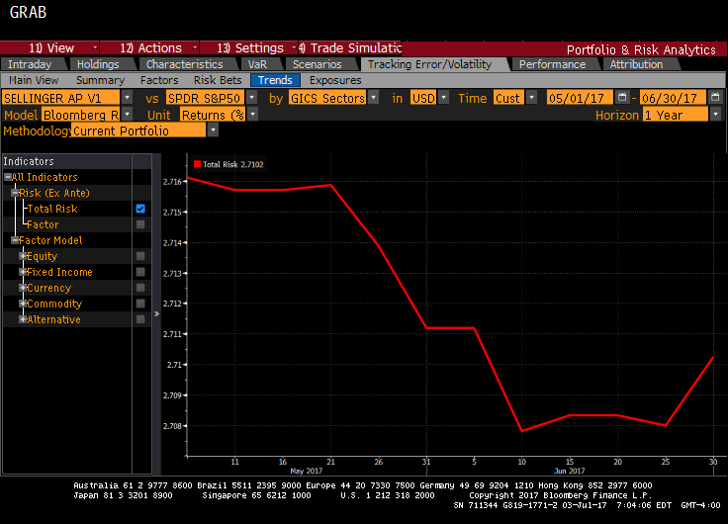
Tracking Error
A measure of the difference between the price behavior of the portfolio versus the benchmark.
Our tracking error was 2.7102 over a one year time horizon. This means we will typically return within +/- 2.71% of the benchmark ⅔ of the year. The goal is to minimize the tracking error while accomplishing higher returns throughout any given time period.
The Tracking Error declined over the first month due to addition of high quality securities.
Overview
Economic Conditions
Sector Review
Portfolio Strategy & Composition
Risk Analysis
Performance Review
Professor & Student Biographies

Slide 68
PERFORMANCE REVIEW

Slide 69
Performance Overview
Our focus will now shift to examining and evaluating the performance of the Sellinger Applied Portfolio (SAP) throughout the Summer 2017 semester (5/15/2017- 6/26/2017). We will compare the performance of the SAP to major United States benchmarks, investigate any significant peaks and/or troughs across daily returns, interpret performance with statistical measures and ratios, reflect if and how our portfolio produced Alpha and Beta variables, and summarize the equities yielding exorbitant returns and those which fell short.
Overview
Economic Conditions
Sector Review
Portfolio Strategy & Composition
Risk Analysis
Performance Review
Professor & Student Biographies

Slide 70
Performance Examination: 5/15/17 – 6/26/17
Overview
Economic Conditions
Sector Review
Portfolio Strategy & Composition
Risk Analysis
Performance Review
Professor & Student Biographies

Slide 71
Benchmark Examination
S&P 500
Mean | 0.000677
Standard Error | 0.000888
Median | 0.000297
Mode | N/A
Standard Deviation | 0.004862
Sample Variance | 2.36E-05
Kurtosis | 7.136306
Skewness | -1.8854
Range | 0.026525
Minimum | -0.01818
Maximum | 0.008347
Sum | 0.020298
Count | 30
Confidence Level (95.0%) | 0.001816
SAP
Mean | 0.001327
Standard Error | 0.001047
Median | 0.002384
Mode | N/A
Standard Deviation | 0.005737
Sample Variance | 3.29E-05
Kurtosis | 5.231115
Skewness | -1.62459
Range | 0.030226
Minimum | -0.01974
Maximum | 0.010489
Sum | 0.039819
Count | 30
Confidence Level (95.0%) | 0.002142
Date | Event
5/17/2017 | Comey, Trump, & Flynn Scandal
6/17/2017 | Amazon / Whole Foods Merger
Overview
Economic Conditions
Sector Review
Portfolio Strategy & Composition
Risk Analysis
Performance Review
Professor & Student Biographies

Slide 72
Key Ratios: 5/15/17-6/29/17
Sharpe Ratio
Sharpe Ratio measures the return relative to each increment of total risk. Over the summer holding period, our return relative to systematic risk exceeded the SPY benchmark.
SAP: -1.53
S&P 500: -1.94
Treynor Ratio
Treynor Ratio measures the return relative to each increment of systematic or undiversifiable risk. Over the summer holding period, our return relative to systematic risk trailed the SPY benchmark.
SAP: -0.0178
S&P 500: -0.0094
Over the holding period, both the portfolio and the S&P 500 returns trailed the risk free rate (3-month U.S. Treasury Bill). Hence, the ratios are negative.
Overview
Economic Conditions
Sector Review
Portfolio Strategy & Composition
Risk Analysis
Performance Review
Professor & Student Biographies

Slide 73
Beta & Alpha: 5/15/17-6/26/17
The graph depicts a regression of the SAP Portfolio returns. The regression looks at the historical return of the SAP Portfolio as compared to the S&P 500 to derive an historical beta and alpha. The regression calculates a beta of 0.68, indicating systematic risk being substantially lower than the market. The regression also provides alpha indicating excess return beyond market predictions. Alpha for the summer portfolio was 0.09%.
Overview
Economic Conditions
Sector Review
Portfolio Strategy & Composition
Risk Analysis
Performance Review
Professor & Student Biographies

Slide 74
Best & Worst Performers: Since Inception
The below reflects performance since the initiation of the position. This includes investments remaining in the Sellinger Applied Portfolio as of 6/26/17.
Stamps.com Inc New | STMP | 37.642%
Adobe Systems Inc | ADBE | 14.632%
Facebook | FB | 14.276%
Health Care ETF | XLV | 13.593%
Technology ETF | XLK | 11.444%
Ubiquiti Networks Inc | UBNT | -0.088%
Procter & Gamble | PG | -0.356%
Wal-Mart | WMT | -3.410%
The Walt Disney Co | DIS | -6.491%
Energy ETF | XLE | -10.658%
Of the five best-performing stocks in the SAP, Stamps.com Inc New, is the real standout, gaining 37.64% in just under three months.
Of the five worst-performing stocks in the SAP, three are summer 2017 acquisitions with Wal-Mart having lost -3.41% over the one month holding period.
Overview
Economic Conditions
Sector Review
Portfolio Strategy & Composition
Risk Analysis
Performance Review
Professor & Student Biographies

Slide 75
Best & Worst Performers: Year-To-Date
The below reflects performance year-to-date, independent of the position inception dates. This includes investments remaining in the Sellinger Applied Portfolio as of 6/26/17.
Adobe Systems Inc | ADBE | 40.81%
Stamps.com Inc New | STMP | 31.92%
Facebook | FB | 30.67%
Stanley Black & Decker | SWK | 24.23%
Blackstone Group | BX | 22.20%
Bristol Myers - Squibb | BMY | -2.60%
Valero Energy Corp | VLO | -3.34%
Ubiquiti Networks Inc | UBNT | -10.73%
The Hacket Groupp | HCKT | -13.08%
Energy ETF | XLE | -14.71%
Overview
Economic Conditions
Sector Review
Portfolio Strategy & Composition
Risk Analysis
Performance Review
Professor & Student Biographies

Slide 76
Best & Worst Performers: Summer 2017 Acquisitions
Top 3 Performers:
Allergan PLC +10.924%
Valero Energy Corp +6.350%
Bristol Myers – Squibb +6.184%
Source: Market Watch 6/26/17
Overview
Economic Conditions
Sector Review
Portfolio Strategy & Composition
Risk Analysis
Performance Review
Professor & Student Biographies

Slide 77
Strategic Acquisitions & Divestitures
Many strategic acquisitions were made during the Summer 2017 term. The fund was focused on industry allocation and overweighting (underweighting) industries that were projected to over-perform (underperform) the S&P 500. Equities were also carefully chosen to fit in the portfolio from a correlation perspective. The fund was targeted to be highly diversified.
Consumer Discretionary (Underweight)
  Liquidated our position in Michael Kors (KORS)
  Liquidated some of our position in Ford (F)
Consumer Staples (Overweight)
  Bought Walmart (WMT)
  Bought Procter and Gamble (PG)
  Bought Tyson (TSN)
Healthcare (Overweight)
  Bought Bristol Myers-Squibb (BMY)
  Bought Allergan (AGN)
Allergan (AGN) had the largest gain among the strategic acquisitions, up over 10% during the holding period.
Overview
Economic Conditions
Sector Review
Portfolio Strategy & Composition
Risk Analysis
Performance Review
Professor & Student Biographies

Slide 78
PROFESSOR & STUDENT BIOGRAPHIES

Slide 79

Dr. Frank P. D’Souza
Professor of Finance
Finance Department Chair
Representative Publications
D'Souza, F., Ellis, N., & Fairchild, L., (2010), "Illuminating the Need for Regulation in Dark Markets: Proposed Regulation of the OTC Derivatives Market", University of Pennsylvania Journal of Business Law, 12, 473-516
Carter, D., D'Souza, F., Simkins, B., & Simpson, W.G., (2010), "The Gender and Ethnic Diversity of US Boards and Board Committees and Firm Financial Performance", Corporate Governance: An International Review, 18(5), 396-414
Simpson, W. G., Carter, D., & D'Souza, F., (2010), "What Do We Know About Women on Boards", Journal of Applied Finance, 20(2), 27-39
D'Souza, F., Fletcher, H., & Ionici, O., (2011), "Equity Market Timing and Subsequent Delisting Likelihood", International Journal of Business and Finance Research, 5(2) 85-94
"Chapter 18: Cost of Capital: An Introduction", Ionici, O. & Small, K. & D'Souza, F., in "Capital Budgeting Valuation: Financial Analysis for Today's Investment Projects". Edited by H. Kent Baker and P. English (2011).
Dr. Frank P. D’Souza earned a Ph.D. from Oklahoma State University, an MBA from St. Cloud State University, Minnesota, and a Bachelor of Commerce from the University of Bombay. He has been published in several academic journals and holds professional memberships with the Finance Management Association, American Finance Association, Eastern Finance Association, Southwestern Finance Association, and Beta Gamma Sigma.
Overview
Economic Conditions
Sector Review
Portfolio Strategy & Composition
Risk Analysis
Performance Review
Professor & Student Biographies

Slide 80
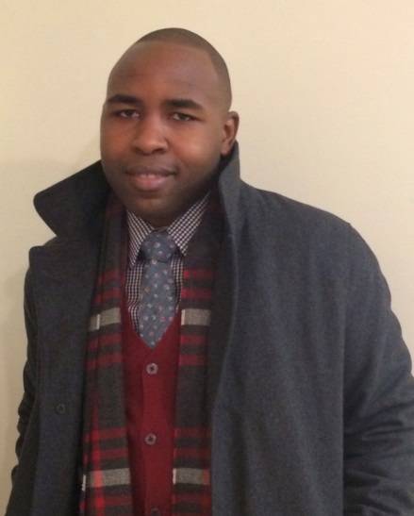

Jessie Austin, Jr. is a graduate student pursuing a MSF from Loyola University Maryland, set to graduate in August 2017. He has a BS in Accounting from University of Maryland University College in Adelphi, Maryland. A former Intelligence Analysis in the U.S. Air Force, Jessie now works as a Financial Analyst for Northrop Grumman, an American global aerospace and defense technology company headquarter in Falls Church, Va.
Jessie Austin, Jr.
Financial Analyst
Northrop Grumman
Vincent Bonasso is a graduate student pursuing an MBA in Finance from Loyola University Maryland, set to graduate in Summer 2017. He has a Bachelor of Science in Industrial Engineering from West Virginia University in Morgantown, WV. Upon graduation, he spent his first two years working for GE in the Commercial Leadership Program. After completing the program, he moved to Baltimore, MD into his current role. Vincent currently works as a Sales Engineer for GE selling electrical distribution equipment in the greater Baltimore/ Washington D.C. area. He currently lives in Columbia, MD with his fiancée Alessandra.
Vincent Bonasso
Sales Engineer
GE
Overview
Economic Conditions
Sector Review
Portfolio Strategy & Composition
Risk Analysis
Performance Review
Professor & Student Biographies

Slide 81
John Buerger is a graduate student pursuing a MSF from Loyola University Maryland. He has also earned a MBA from Hood College and a BA in Business Administration from Flagler College. He is currently working for Corporate Office Properties Trust, a REIT in Columbia, MD, as an Analyst on their Financial Planning & Analysis team. Prior to joining COPT he worked as a Risk Analyst. He plans on taking the first level of the CFA next fall.
John Buerger
Financial Analyst
Corporate Office
Properties Trust
Joey Cahalan joined Brown Advisory in July 2015 as a Business Development Associate. Prior to joining Brown Advisory, Joey spent two years interning with Morgan Stanley and Deutsche Bank. Joey graduated from Loyola University Maryland with a BA in Business Administration in May 2015. He will graduate with his Masters of Science in Finance in 2017. Prior to that, Joey worked in the Maintenance Department at Padonia Park Club for eight years. He volunteers for Junior Achievement and is a member of the Gilman School Alumni Board of Governors.
Joey Cahalan
Business Development
Associate
Brown Advisory
Overview
Economic Conditions
Sector Review
Portfolio Strategy & Composition
Risk Analysis
Performance Review
Professor & Student Biographies

Slide 82


Elizabeth (Liz) Colgan is a graduate student at Loyola University pursuing her MSF. She will graduate in September of 2017 upon completion of the Prague & Berlin Study Tour. Liz was a member of Loyola’s graduate team for the 2017 CFA Institute Research Challenge. She is employed as a Registered Client Associate for The Shaeffer Investment Group of RBC Wealth Management (FINRA Series 7 & 66 Licenses obtained). Liz was raised in Hunt Valley, Maryland where she attended Notre Dame Preparatory School. She then earned her Bachelor of Arts in Economics from the University of Virginia in May of 2014. During her time at UVa., she was a member of the varsity women’s lacrosse team and earned First-Team All-American Honors and the C. Markland Kelly Award in her senior season.
Elizabeth Colgan
Registered Client Associate
RBC Wealth Management
James DiLuzio is anticipating graduation from Loyola University Maryland in the Spring of 2018 with a M.S. in Finance. Prior to studies at Loyola, Jimmy graduated magna cum laude from West Chester University of Pennsylvania in 2015 with a B.S. in Finance and a Minor in Accounting. During those years, James worked at the Berkshire Hathaway-owned Property and Casualty Insurance Carrier – United States Liability Insurance Group (Wayne, PA) and represented Finance majors under the Student Advisory Board within WCUPA’s College of Business and Public Affairs. Following graduation, he transitioned to a financial services role at SEI Investments Company in Oaks, PA. James is currently an Operations Manager for CVS Health Corporation and is approaching a cumulative five-year employment anniversary with the healthcare company. In the fall of 2017, he will also represent the graduate students of Loyola University Maryland’s School of Arts and Sciences, School of Education, and the Sellinger School of Business and Management as a Graduate Assistant in The Office of Student Development.
James DiLuzio
Operations Manager
CVS Health Corp
Overview
Economic Conditions
Sector Review
Portfolio Strategy & Composition
Risk Analysis
Performance Review
Professor & Student Biographies

Slide 83


Mike Fields is a graduate student pursuing a MSF at the Sellinger School of Business from Loyola University Maryland, set to graduate in October 2017. He also earned a MBA in 2014 and a Bachelor of Science in Finance in 2013 from Mount St. Mary’s University. While at Mount St. Mary’s, he was a member of the Men’s Division One Lacrosse team. Mike is currently a Financial Analyst at Northrop Grumman in Baltimore, MD and has worked there since 2014.
Michael Fields
Financial Analyst
Northrop Grumman
Michael Hammer is a graduate student pursuing a MBA from Loyola University Maryland. In addition to his graduate studies, he has earned a Bachelor of Science in both Aerospace and Mechanical Engineering from The University of Florida. Michael is employed by GE Industrial Solutions where he works as a Technical Sales Account Manger calling on some of the largest Electrical contractors in the United States. In this role, he generates and supports the execution of technical proposals with both contractor and owner based solutions for the electrical distribution infrastructure of a building. While much of the construction work in the DMV is commercial many of Michael’s accounts excel at Higher education, Hospital and Data Center projects. Michaels long term aspirations are in business management and leveraging big data in conjunction with industry knowledge to garner market growth.
Michael Hammer
Technical Sales & Account Manager
GE Energy Management, Industrial Solutions
Overview
Economic Conditions
Sector Review
Portfolio Strategy & Composition
Risk Analysis
Performance Review
Professor & Student Biographies

Slide 84

Sumit Joshi is a graduate student at Loyola University, pursuing MS Finance with an expected graduation dated of August 2017. He is currently with T. Rowe Price located in Baltimore, MD as a Senior Business Analyst in Product Management group where he primarily works on US Mutual Funds. His responsibilities include managing launch of new funds, performing ad hoc requests on existing funds and conducting market research. Prior to joining T. Rowe Price in 2014, Sumit was A Business Intelligence Analyst at Greenspring Associates, a venture capital fund-of-funds located in Owings Mills, MD. Sumit holds a B.S. in Aviation Business Administration from Embry-Riddle Aeronautical University.
Sumit Joshi
Sr. Business Analyst
T. Rowe Price
Ila Kale is a graduate student pursuing her MSF from Loyola University Maryland. In addition to her graduate studies, she earned a Bachelor of Science in Industrial and Systems Engineering from the Georgia Institute of Technology. Professionally, Ila is a Risk Analyst at Java Productions Inc. focusing on Enterprise Risk Management in the Federal Government. Previously, she spent three years at Raytheon Company as a Logistics Engineer focusing on the implementation of Six Sigma Methodology.
Ila Kale
Risk Analyst
Java Productions Inc
Overview
Economic Conditions
Sector Review
Portfolio Strategy & Composition
Risk Analysis
Performance Review
Professor & Student Biographies

Slide 85

Rachel Knickerbocker is a graduate student pursuing a MBA from Loyola University Maryland. In addition to her graduate studies, she earned a BS in Accounting with a minor in Economics and Mathematics from Elon University in 2010. After graduation, Rachel was an Auditor at KPMG and then continued on to Millennial Media to be an Accounts Receivables Accountant. Rachel made the transition to a Financial Analyst role in 2014, and is currently employed by Sinclair Broadcast Group as a Senior Financial Analyst in Corporate Development. In her Corporate Development role, Rachel analyzes potential acquisitions and strategic investments to improve Sinclair Broadcast Group’s financial position.
Rachel Knickerbocker
Senior Financial Analyst
Corporate Development
Sinclair Broadcast Group
Paula Kocen will complete her MBA with a concentration in Finance from Loyola University Maryland in December 2017. She currently holds a BS in Mathematics and Computer Science from the Pennsylvania State University. Paula has worked in the Information Technology (IT) field her entire career, primarily in the Manufacturing and Engineering industry. She spent 18 years working at Johnson Controls, Inc. first as a software developer, and then in management leading a global team of developers in the U.S., China, and Europe. She also spent several years developing IT strategic plans and project portfolios. Upon graduation, Paula plans to transition to a finance-related career.
Paula Kocen
IT Manager
Overview
Economic Conditions
Sector Review
Portfolio Strategy & Composition
Risk Analysis
Performance Review
Professor & Student Biographies

Slide 86
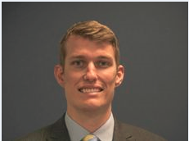
Peter Lund is a graduate student pursuing a MSF from Loyola University Maryland. He is currently employed as an Accountant at Atapco Properties, located in Baltimore, MD, and is responsible for accounting related duties for a portfolio of operational properties. He finished his undergraduate studies at the University of Maryland and holds a BS in Business Administration. He is also currently awaiting the results from the final portion of the CPA exam.
Peter Lund
Accountant
Atapco Properties
Keith Masiulis is a graduate student at Loyola University, pursuing an MBA with a concentration in Finance. He is currently employed as a senior financial analyst focused on topline analytics and strategy for PepsiCo and is responsible for modeling, forecasting, and execution of PepsiCo’s Mid-Atlantic business which brings in $1.6B in revenue. Prior to joining PepsiCo in 2013, Keith worked as a financial analyst for Constellation Energy and helped transition its FP&A team through the merger with Exelon and graduated from Loyola University with a BBA in Finance in 2010. He volunteers on various committees such as Ronald McDonald House and Loaves & Fish throughout Baltimore City and enjoys skiing, golfing and cooking with friends and family.
Keith Masiulis
Senior Financial Analyst
PepsiCo
Overview
Economic Conditions
Sector Review
Portfolio Strategy & Composition
Risk Analysis
Performance Review
Professor & Student Biographies

Slide 87
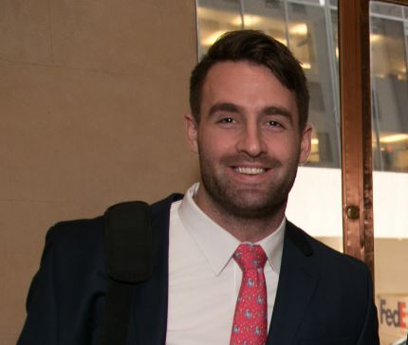
Michael McCarthy will complete the MSF from Loyola University Maryland in December 2017. He currently works in Capital Markets at Fannie Mae in Washington D.C. Prior to landing in his current position, he was in the finance rotation program at Fannie Mae for a year and a half. He earned a BS in Business Administration with a concentration in Economics from Towson University in Baltimore, MD. Upon graduating, he enlisted in the United States Marine Corps and currently serves as a reservist.
Michael McCarthy
Capital Markets
Fannie Mae
Lisa Murawski is a graduate student pursuing a MSF degree from Loyola University Maryland. Lisa works as an Investment Analyst at Knollwood Investment Advisory where she is responsible for private equity and venture capital due diligence and investment recommendations, as well as market research and data analysis. Lisa received her undergraduate degree from Loyola University Maryland in 2011, majoring in accounting and completing a double minor in Spanish and Information Systems, and she also holds an MBA with a concentration in Finance from Loyola. She also completed the Investment Banking Institute's Financial Modeling and Valuation Program in 2017. Prior to joining Knollwood, Lisa worked in the Assurance practice at Ernst & Young, primarily serving private equity and consumer products clients. Lisa is also a Certified Public Accountant, a member of Alpha Sigma Nu, and participates on the Young Professionals Board for the Back on my Feet Baltimore chapter.
Lisa Murawski
Investment Analyst
Knollwood Investment Advisory
Overview
Economic Conditions
Sector Review
Portfolio Strategy & Composition
Risk Analysis
Performance Review
Professor & Student Biographies

Slide 88

Alyssa Stine is a graduate student at Loyola University Maryland, pursuing a Master of Science in finance. She is currently employed in the analytics division as a reverse engineering consultant for Wells Fargo. Her primary roles include: new deal modeling in the Intex language, cash flow/price/yield tie out & projections, and legacy portfolio support. Previously, she has held senior analyst roles with Wells Fargo. She possesses expertise in various areas of structured finance, including: securitization, residential mortgage backed securities, collateralized debt/loan obligations, repos, trade execution & support, and legal document oversight. She received a Bachelor of Arts from St Mary’s College of Maryland in 2014 with dual majors in mathematics and economics.
Alyssa Stine
Reverse Engineering Consultant
Wells Fargo
Mike Sutter is an Associate in CohnReznick Capital’s (“CRC”) investment banking practice. Mike is located in the firm’s Baltimore Office.
Mike focuses on middle-market special situations, restructurings, and recapitalizations at CohnReznick Capital. Mike has experience providing restructuring services across a wide range of industries, including debt restructuring in and out of bankruptcy, DIP and exit financing, §363 sales processes, valuations, and litigation support, among others. Mike has experience advising both companies and creditors in a variety of circumstances. Prior to CRC, Mike worked at Stifel Nicolaus where he focused on credit and rate strategies. Mike earned a B.A. from Washington College.
Michael Sutter
Associate
CohnReznick Capital
Investment Banking
Overview
Economic Conditions
Sector Review
Portfolio Strategy & Composition
Risk Analysis
Performance Review
Professor & Student Biographies

Slide 89
Philip Valle is a soon to be MBA graduate from Loyola University, with a concentration in Finance. With a double major in Finance and Management & a minor in economics from the University of Delaware, Philip began his career in Private Asset Management at T. Rowe Price. After several years he shifted away from the mutual fund industry, and landed a position as a risk analyst in the energy industry at Constellation Energy. Since the merger with Exelon, Philip has fulfilled various roles and now works on the Midwest gas trading desk.
Philip Valle
Natural Gas Trader
Exelon Generation
Overview
Economic Conditions
Sector Review
Portfolio Strategy & Composition
Risk Analysis
Performance Review
Professor & Student Biographies

